Slide 1


From Progress to
Progress +
What does it mean for Clinical Leads and Services
Dr Cathryn Chadwick VP (Training & Assessment) RCPCH

Slide 2
Progress: 2018
To ensure the curriculum equips doctors with generic skills
‘High level’ outcomes based curriculum
Based on generic professional capabilities
Move away from tick box, time based training
Capability based training
Subspecialty curricula aligned to Progress
Preparation for greater flexibility
Better aligned to future ways of working
Notes:
The introduction of Progress in 2018 was a major curricular change, moving away from a rigid, tick box approach to an outcome based curriculum based on generic professional capabilities. This has paved the way for greater flexibility and to train paediatricians who will be better able to work across a wide range of settings. As a ‘high level’ curriculum it has less granular detail and therefore depends on good supervision to support trainees.

Slide 3
Moving to Progress+: 2023
Structural Change
Reduction in the overall indicative length of training from eight to seven years
Change to two training levels; Core Paediatrics (Year 1-4) and Specialty Paediatrics (year 5-7)
Changes with a view to improving flexibility:
Embedding capability rather than time-based training
Increased flexibility and breadth of placements to develop good quality core training.
Moving away from fixed 6m blocks at specific training points for all trainees.
Mapping of similarities between sub-specialties so trainees can change pathway and count capabilities already achieved
Promotion of OOP opportunities
Notes:
Progress + is not a significant change in curricular content, the main changes are to the structure of training and to introduce even more flexibility to training.

Slide 4

Core Paediatrics
ST1 | ST2 | ST3 | ST4
Tier 1 | Transition to tier 2 |  | Tier 2
New Core Training Programme Core curricular capabilities in General Paediatrics, Neonatology, Integrated (Primary/Secondary) Care, Public Health, Community Child Health, Child & Adolescent Mental Health Includes sub-specialty placements Trainees will transition to tier 2 working by the end of ST3, with suitable support, supervision and assessment. |  |  | ST4 trainees will be on tier 2 rota.
Specialty Paediatrics
ST5 | ST6 | ST7
All trainees follow the Generic Syllabus plus one of the specific syllabi below:
General Paediatrics
 | SPIN optional
Sub-specialty Paediatrics
 | Sub-specialty 1
 | Sub-specialty 2 | …etc.
Sub-specialty Paediatrics
 | Sub-specialty 3 | …etc.
CCT Paediatrics
SPIN (If done)
Possible post CCT SPIN
CCT Paediatrics
(Sub-specialty)
MRCPCH Theory
MRCPCH
Clinical
MRCPCH
Clinical
START
Notes:
Outline of the new 2 tier training programme.
All 3 parts of the MRCPCH exam must be passed by the end of ST3 and the full clinical by the end of ST4.
There is an emphasis on enhancing decision making skills and a supported transition to middle grade working during ST3. There will not be mandated placements at specific points (eg community or neonates during ST4). Core training should include a wide range of settings and opportunities)

Slide 5
Core Paediatrics |  |  |  | OOP
ST1 | ST2 | ST3 | ST4 | Pause
Tier 1 | Transition to tier 2 |  | Tier 2 | Tier 2
New Core Training Programme Core curricular capabilities in General Paediatrics, Neonatology, Integrated (Primary/Secondary) Care, Public Health, Community Child Health, Child & Adolescent Mental Health Includes sub-specialty placements Trainees will transition to tier 2 working by the end of ST3, with suitable support, supervision and assessment. |  |  | ST4 trainees will be on tier 2 rota. | Out of Programme
Specialty Paediatrics
ST5 | ST6 | ST7
All trainees follow the Generic Syllabus plus one of the specific syllabi below:
General Paediatrics
 | SPIN optional
Sub-specialty Paediatrics
 | Sub-specialty 1
 | Sub-specialty 2 | …etc.
Sub-specialty Paediatrics
 | Sub-specialty 3 | …etc.
CCT Paediatrics
SPIN (If done)
Possible post CCT SPIN
CCT Paediatrics
(Sub-specialty)
MRCPCH Theory
MRCPCH
Clinical
MRCPCH
Clinical
START
Notes:
OOP will be encouraged and it is hoped that schools will enable trainees to take up opportunities. OOP can betaken at any point allowed by the Gold Guide, one logical time to take OOP is after Core training.

Slide 6
Core Paediatrics
ST1 | ST2 | ST3 | Pause | ST4
Tier 1 | Transition to tier 2 |  | Tier 2 | Tier 2
New Core Training Programme Core curricular capabilities in General Paediatrics, Neonatology, Integrated (Primary/Secondary) Care, Public Health, Community Child Health, Child & Adolescent Mental Health Includes sub-specialty placements Trainees will transition to tier 2 working by the end of ST3, with suitable support, supervision and assessment. |  |  | Out of Programme | ST4 trainees will be on tier 2 rota.
Specialty Paediatrics
ST5 | ST6 | ST7
All trainees follow the Generic Syllabus plus one of the specific syllabi below:
General Paediatrics
 | SPIN optional
Sub-specialty Paediatrics
 | Sub-specialty 1
 | Sub-specialty 2 | …etc.
Sub-specialty Paediatrics
 | Sub-specialty 3 | …etc.
CCT Paediatrics
SPIN (If done)
Possible post CCT SPIN
CCT Paediatrics
(Sub-specialty)
MRCPCH Theory
MRCPCH
Clinical
MRCPCH
Clinical
START
Notes:
Some trainees might choose to take OOP at the end of ST3 and before moving fully to the tier 2 rota.

Slide 7
Progress+ Transition planning
Progress+ Transition planning
Existing pathway
ST1 | ST2 | ST3 |  | ST4 | ST5 |  | ST6 | ST7 | ST8
*
ST1 | ST2 | ST3 | ST4 |  | Old ST5 posts |  | Specialty Training
Progress+ pathway
*
Trainee flexibility; to remain in Core or progress to Specialty
Notes:
Showing what will happen to trainees in August/September 2023 at the point of transition. Those finishing ST4 will have a choice to move into Specialty training or to remain in core. This and the following slides refer to Full time trainees who have no statutory leave or OOP

Slide 8
Core Training
ST1-4
Curriculum mandates capabilities in:
  CAMHS
  Public Health
  Working across primary/secondary care and ICS settings
Learning is about ‘how’ not ‘what and where’
  Enhanced supervision
  No mandatory placement
  Hands on supervision to improve early decision making skills
  Formal assessment for readiness for tier 2 working
  Expectation of core training to include General Paediatrics, Neonates, Community, CAMHs, public health.
Notes:
The main changes are to core training. Trainees will need to acquire capabilities in CAMHS, public health and experience across different primary and secondary/tertiary care settings.
Trainees no longer have to do mandatory placements in community child health and neonates as they used to in the ‘old’ level 2 training.
Supervision will be needed to give trainees good decision making skills and trainees will be formally assessed for their readiness to move onto the tier 2 rota

Slide 9
Core Training
Tier 2 transition to begin in ST2-3
  Holding the registrar bleep
  Running the ward round with supervision
  Decision making on acute take
  Supervision to be responsive and on site
Assessment for independent Tier 2 working
  ECAT (neonatal admission/acute take)
  Supervisors report
  NLS/APLS
Independent Tier 2 working
  Remote but responsive supervision
  By start of ST4 or earlier
Notes:
Depending on progress and previous experience, trainees will be expected to start gaining tier 2 capabilities during ST2/3. This should start with close supervision.
Trainees will have a formal assessment of readiness for independent tier 2 working and be expected to be fully independent on the tier 2 rota by the start of ST4.
This may be earlier as already happens

Slide 10
Specialty Training
ST 5-7
Very similar to current Level 3 training
  70% General paediatrics
  30% subspecialty
Specialty Level will have indicative 3y training
Flexibility to move between subspecialties
General paediatric trainees should have subpecialty training opportunities.
SPIN curricula will continue but also be open to post CCT holder.
Implementing Progress+ will help to encourage both trainee and trainer to think more creatively in their approach to Paediatric training; something of which was a key focus in producing the Paediatrician of the Future document.
Notes:
Very few changes for Specialty training.
Trainees will be coming into this level with less experience than previously and there is flexibility to move between specialties. Time to CCT will be 3y and therefore all subspecialty programs can have an indicative 3y length. As currently, some programs and trainees will progress quicker.

Slide 11
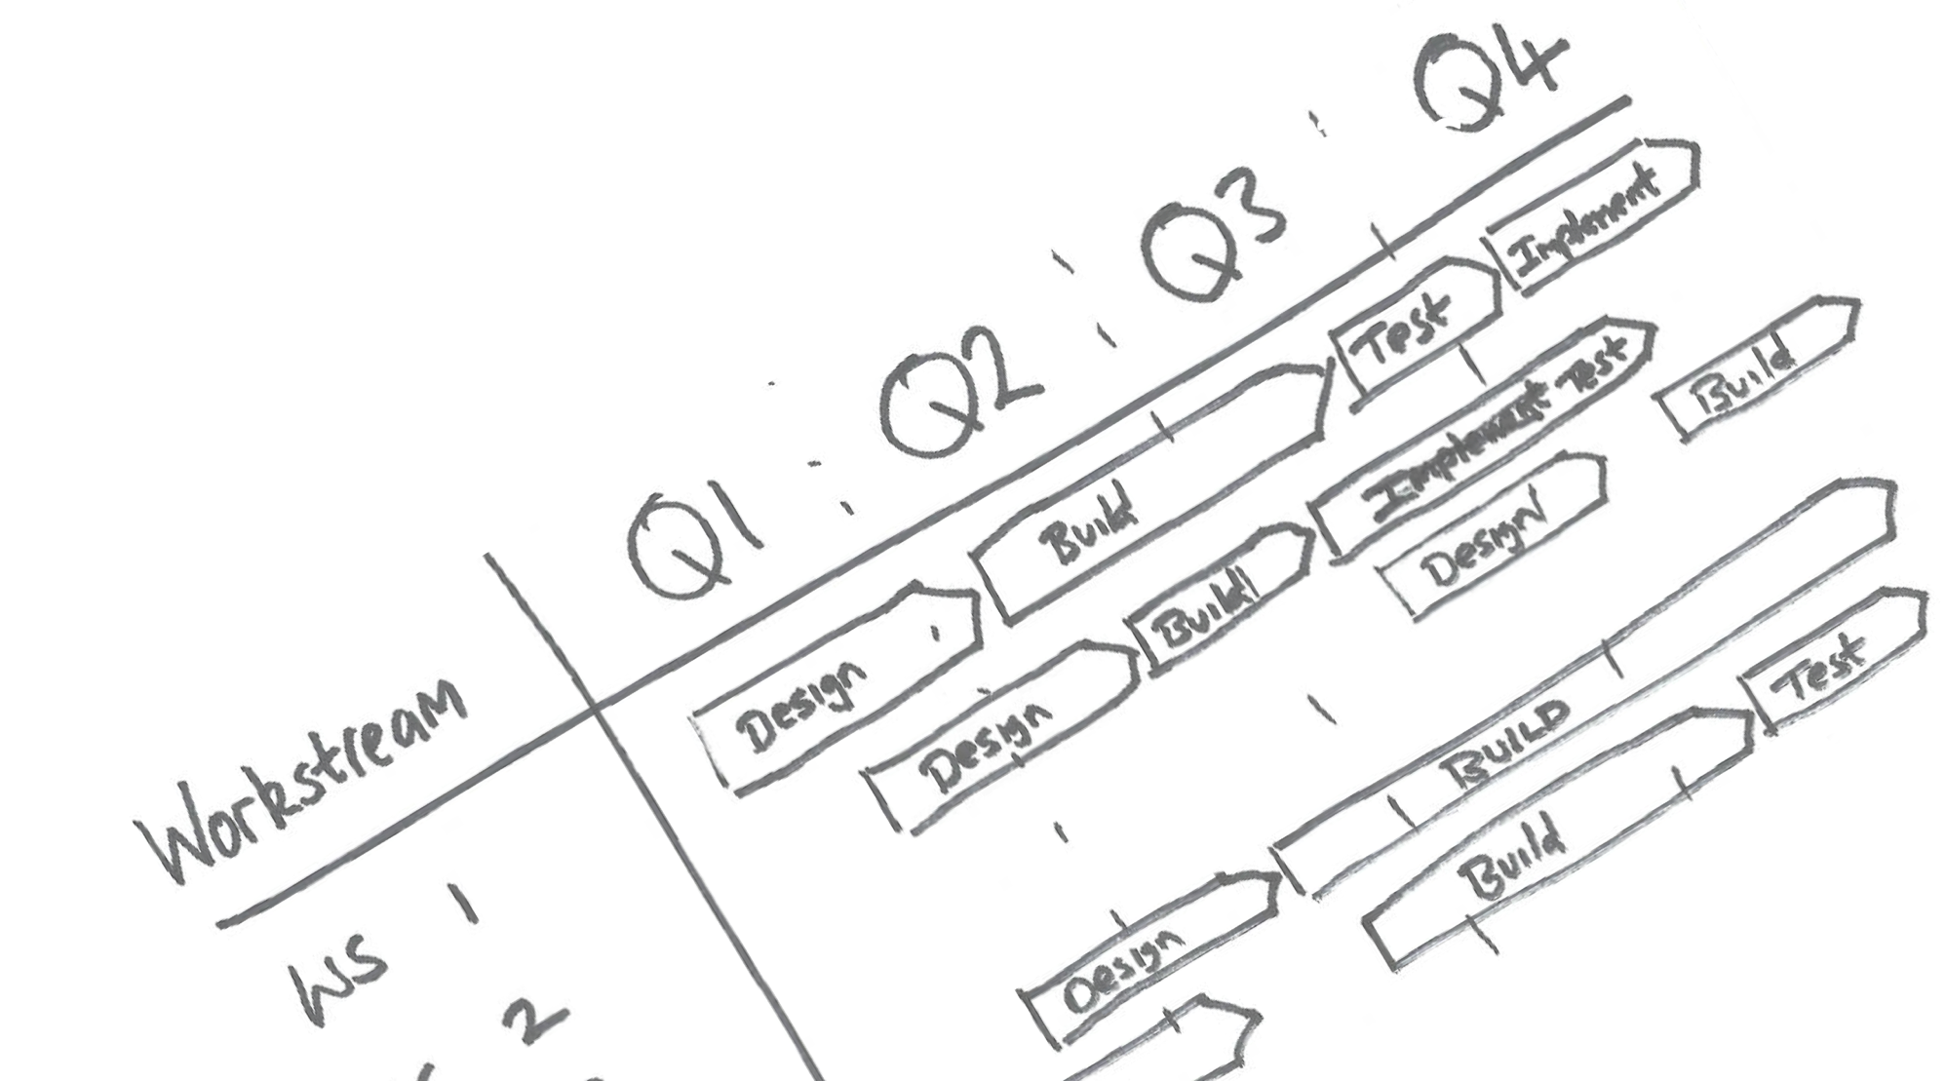
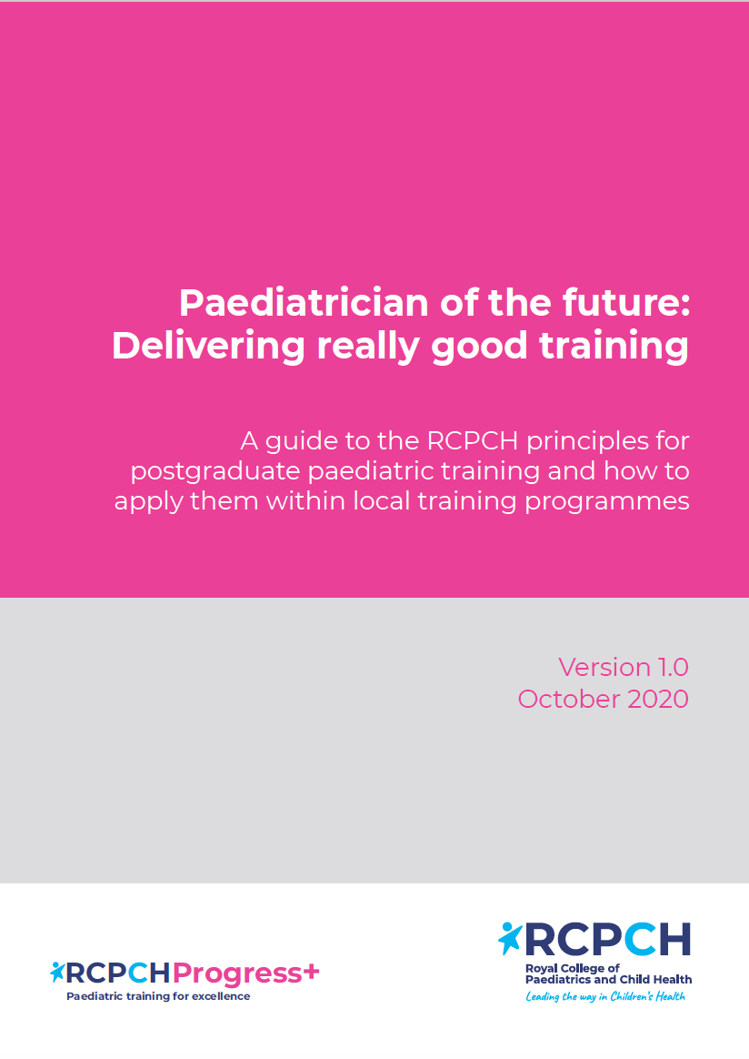
Paediatrician of the Future: Delivering really good training
Describes the principles of an excellent training programme.
Training Principles
Every patient encounter is a learning opportunity
Complex case management provides rich learning opportunities
Clinical reasoning skills are explicitly taught
Patients and families are heard
A biopsychosocial approach is applied at all times
Leadership skills are developed and nurtured
Learning opportunities are prioritised within workplace
Educational supervision is high quality and consistent
Morale and job satisfaction are improved
Assessment is used as a learning tool
Progression and length of training are personalised
…less concerned with the what and where
… more concerned with the how….
Notes:
This document is designed to be used alongside Progress+ to make sure that training and learning is broad and that all generic capabilities are met. The curriculum does not just concentrate on acute clinical paediatrics but ensures that capabilities across child mental health, public health are achieved. The aim is to train doctors who can practice holistically and across a wide range of settings. Making sure that trainees get really good training will depend on supervisors being familiar with the curriculum and these principles.
An apprentice model of training is not enough. Time needs to be spent actively training according to these principles.

Slide 12
Considerations for service
Placements:
Increased flexibility in placements: moving away from 6m blocks at specific training points for all trainees.
May have less experiences ST1-3 trainees in some placements (eg Community and neonates)
Flexibility for more experienced trainees to do additional placements in community/neonates
Core Trainees will need to spend some time away from acute service

Slide 13
Considerations for service
Rotas:
1. Gradual transition to tier 2 working
2. Earlier acquisition of tier 2 working skills, but will require more supervision
3. Implications for out of hours consultant working with more junior registrars in some units.

Slide 14
Considerations for service
Learning
1. Need to learn from mental health cases in a variety of clinical settings: (acute ward, ED, primary care)
2. Longitudinal educational supervision is recommended
3. An apprenticeship model is not enough: Active training needs dedicated trainer time
4. Trainers need time to supervise trainees and assess readiness for tier 2 working
5. Self development time as per Trainee charter is vital.
Notes:
the need to give trainees self development time and for them to access training opportunities in CAMHS etc away from the acute ward, means that they will be less available for acute rotas. Supervision is key to delivering the curriculum.

Slide 15
Transition Period 2023 onwards
How will trainees transition?
Numbers and staffing implications
What can clinical leads do now

Slide 16
Trainees finishing ST1-ST3 in Summer 2023
Will move from Level 1 training to core training at ST2-4
Expect an indicative 7 years in paediatric training
Will transition to tier 2 rota during ST3 (or before)
Will be fully on tier 2 rota in ST4
Will start to transition to tier 2 rotas without the full MRCPCH exam

Slide 17
Trainees finishing ST5- ST7 in Summer 2023
Unchanged expectations of total 3 years in ‘higher’ paediatric training.
CCT date remains unchanged
Specialty training under Progress+ (previously level 3)
  General Paediatrics
  or
  Sub-specialty training
Notes:
Trainees who would be finishing level 2 or already in level 3 at the start of the 2023/24 training year will still have 3 years of training at this level. This was previously Level 3, now known as Specialty training. As previously most (70%) will go into general paedaitrics, 30% will be in subspecialties (via a central competitive application process)

Slide 18
Trainees finishing ST4 in Summer 2023
This group have a choice:
Either:
Remain in core training
Indicative CCT date 2027
Move into specialty training in August/September 2024
Or:
Move straight to Specialty Training
  General Paediatrics
  or
  Sub-specialty training (applying in 2022/23 application round)
Indicative CCT date 2026
Notes:
This group of trainees can choose to stay in core training which means they will have an overall 8y training or move straight to Specialty training and therefore have an overall 7y training pathway

Slide 19
Trainees finishing ST4 in Summer 2023
Why Remain in Core Training?
For additional experience before Specialty Training
To increase preparation and application opportunities for Sub-Specialty Training
If level 2 capabilities have not been fully met
Why move straight into Specialty Training?
Completed all Level 2 capabilities
Ready to progress
Appointed to sub-specialty training in 2022/23 recruitment
THIS IS A DECISION BASED ON TRAINING NEEDS AND MUTUALLY AGREED BETWEEN TRAINEES AND TRAINERS
NB – outcomes of sub-specialty applications for 2022/23 will be released BEFORE these trainees have to formally decide if they want to remain in Core or move into Specialty Training
Notes:
The decision to remain in Core or move to Specialty Training will depend on trainee choice and capability after discussion between trainers and trainee. If a trainee wants to move from ST4 to sub-specialty training in August/September 2023, they will apply for their chosen sub-specialty in the 2022/23 recruitment round. They will need to be on track to complete all Level 2 capabilities by the start of Sub-specialty training. This does not depend on specific placements but there will need to be early discussion and planning to ensure that placements are suitable to enable the trainee to meet the L2 capabilities.

Slide 20
What does this mean during transition period?
ST1-3 numbers unchanged
Will need more time away from acute rotas
ST6-7 numbers unchanged
Bulge in trainees at ST4/ST5
May have an increase in OOP
Potential for old ST5 posts in NNU/CCH to be unfilled or filled with less experienced trainees.
Decision about how to use previous ST5 posts may not be finalized until Feb/March 2023
Increased competition for sub-specialty posts
More supervision time needed

Slide 21
Beyond the transition period
Bulge in CCT holders finishing in 2026-2028
Working with SEBs to maintain overall trainees numbers
Workforce data and planning continues to be key to inform training numbers and needs between general paediatrics and subspecialties
RCPCH working closely with all stakeholders to address workforce issues.
Continued move to more multiprofessional workforce anticipated over time.
Joint RCPCH/HEE ACP curriculum in development to support this.

Slide 22
Next steps:
Trainees:
  Discussing training pathway with supervisors/TPDs
  Thinking about future career plans
College Tutors
  Planning and delivering local events to educate trainees and trainers
  Promoting ‘the paediatrician of the future’ document
  Developing local teaching and training links with related specialties (CAMHS, Public health, primary care)
  Become familiar with Progress+ curriculum
Schools
  Reviewing placements and any necessary post reconfiguration
  TPDs working with trainees to plan training pathways
  Reviewing supervision models and moving to longitudinal supervision
  Working with units to provide subspecialty taster opportunities

Slide 23
Next steps: Clinical Leads
Discuss post reviews with TPD/Head of school
Review rotas to improve balance of service/training and to facilitate self development time.
Consider creating innovative and attractive OOP opportunities
Widen multiprofessional and AHP workforce.
Review local supervision models
Review consultant working patterns
Identify opportunities for enhanced training links with CAMHS, Public health and working with ICS
Notes:
There are opportunities to look at rotas and working patterns across all groups. To build and strengthen the AHP and multiprofessional workforce and to build links across other specialties for shared training opportunities.
As we expect more OOP, this is an opportunity to create fellow posts with innovative content that would be attractive and keep local trainees contributing to service as well as giving them flexible pathways.

Slide 24

Progress+ will be implemented in August/September 2023
2023

Slide 25
Progress+ Curriculum
For more details..
Check out our information packed landing page on the RCPCH website, devoted to updates and announcements about the move to Progress+.
Just type in ‘Progress+’ in the search box on the website to find out more!
For questions and advice email: progress-plus@rcpch.ac.uk
RCPCH Training and Assessment team are very happy to support college tutors or schools with resources, planning or delivery of local events.

Slide 26
Any Questions?

