Slide 1
Domain 2: Communication

Slide 2

Highlights
GMC guidance
Child-centred & family-centred care
Communicating with adolescents
Tips for managing emotions during difficult consultations
Communicating with colleagues
Where does your personality type fit in?
Top tips for “Written Communication”
Safe Handover & helpful communication tools
Useful training and resources.
Notes:
Image = Pixabay.com

Slide 3
Curriculum overview
Structural changes
  Reduction in the overall indicative length of training from eight to seven years.
Change to two training levels
  Core Level Paediatrics (Year 1-4)
  Specialty Level Paediatrics (year 5-7)
Changes with a view to improving flexibility:
Embedding capability rather than time-based training
Removal of the requirement to do six-month blocks (eg neonates, community child health).
Mapping of similarities between sub-specialties so trainees can change pathway and count capabilities already achieved.
Promotion of OOP (out of programme) opportunities

Slide 4
Core Level –
Curriculum Learning Outcome 2
This domain requires trainees must develop strong communication skills to navigate the complexities of paediatric practice. This includes key consultation techniques, fostering partnerships, managing difficult situations, and collaborating with healthcare teams. Effective written communication is also essential, ensuring clear, accurate records.
Throughout training, trainees must demonstrate respect, cultural awareness, and professionalism. By the end of core training, they should be capable of handling more complex discussions and producing acceptable written reports, though legal reports may still require supervision.
Core Learning outcome | Key capabilities
Develops effective professional relationships with babies, children, young people and their families/carers as well as colleagues, enabling active participation in planning and implementation of care plans – this will include demonstrating listening skills, cultural awareness and sensitivity; communicating effectively in the written form by means of clear, legible and accurate written and digital records. | Understands the principles of participation in decision making for children, young people and their parents in the process of improving their health. Demonstrates excellent communication skills, both spoken and written (including electronic notes) with children, young people, families and colleagues. Demonstrates excellent communication and interpersonal skills to enable effective collaboration with children, young people and their families, including colleagues in multi-disciplinary teams (MDTs). Demonstrates courtesy and respect for different cultures and those with protected characteristics. Responds appropriately and empathises with children, young people and their families in dealing with conflict and/or those who are experiencing difficulty, anxiety or distress. Manages the communication of a range of differential diagnoses and where the management plan will be uncertain.

Slide 5
Specialty Level –
Curriculum Learning Outcome 2
Within this domain, the trainee will work increasingly in an unsupervised role within multidisciplinary teams and apply communication skills with children, young people and families/ carers in a range of environments and challenging situations.
Communication skills will be developed across the entire range of paediatric healthcare settings and all levels of complexity.
Specialty Learning outcome | Key capabilities
Applies communication skills in a range of contexts, for example, in multi-disciplinary teams (MDTs), with children, young people, families/ carers, external agencies and other professionals, across a range of media, including legal and child protection reports. | Effectively communicates with the multi-disciplinary team (MDT), children, young people and their families, where there is a range of differential diagnoses and management is uncertain. Models and teaches effective active listening skills in consultation with children and young people. Demonstrates to others how to manage an effective consultation, including communicating a diagnosis and prognosis effectively to children, young people and their families. Leads MDT in a range of situations with children, young people and their families, including challenging circumstances. Demonstrates effective communication with external agencies, including authoring legal documents and child protection reports.

Slide 6
Underpinning knowledge
Communication
Information transfer. Multiple mechanisms to support written communications
Managing challenging and difficult conversations
Situational, cultural and social awareness
Verbal and non- verbal.
Doctor patient relationships. Engaging children and young people.

Slide 7

Getting the basics right
Notes:
Introducing yourself to patients and colleagues is not only a common courtesy but fundamental to establishing relationships that enable effective communication. The “Hello My Name is” campaign was born out of Dr. Kate Granger’s own personal experience as a patient.
https://www.hellomynameis.org.uk/

Slide 8


Guidance on communicating with CYP (GMC 2007)
Treat CYP as individuals
Listen to and respond to concerns.
Give them information in a way that they understand.
Work in partnership with CYP & their families/carers.
Notes:
The GMC’s guidance on caring for Children and Young People (CYP) is underpinned by ethical principles and the United Nations Convention on the Rights of the Child (GMC, 2007; UNICEF, 1990).
GMC’s guidance instructs doctors to:
treat CYP as individuals, with consideration, respect, honesty and without discrimination
listen to and respond to their concerns
give them information that they want or need in a way they can understand.
The Royal College of Paediatrics and Child Health (RCPCH) leads the way for child health on a national and global scale. Their strategic aim to improve child health and wellbeing through advocacy, engagement, partnership and empowerment has led to a more child-centred focus to paediatric policy and education (RCPCH, 2018)
Assessment Link: Mini-CEX, DOPs, 360 feedback
References:
GMC (2007) 0-18 years: Guidance for all doctors. [Online]. Available from: doi:ISBN: 978-0-901458-29-.
RCPCH (2018) Royal College of Paediatrics and Child Health 2018-2021 strategy and 2018-2019 Council identified priorities. [Online].
UNICEF (1990) The United Nations Convention on the Rights of the child.
Further resources:
Me first, children and young people centred communication, accessed 31.1.2019 [online] https://www.mefirst.org.uk/
Department of Education (n.d.) Top Tips for Professionals who support CYP to participate in their EHCP.
Mencap (2014) Communicating with people with a learning disability. Voice of the learning disability. [Online] 6. Available from: https://www.mencap.org.uk/sites/default/files/2016-12/Communicating with people_updated %281%29.pdf.
The National Council for Palliative Care (n.d.) What should you tell children about death? [Online] Available from: www.dyingmatters.org.

Slide 9
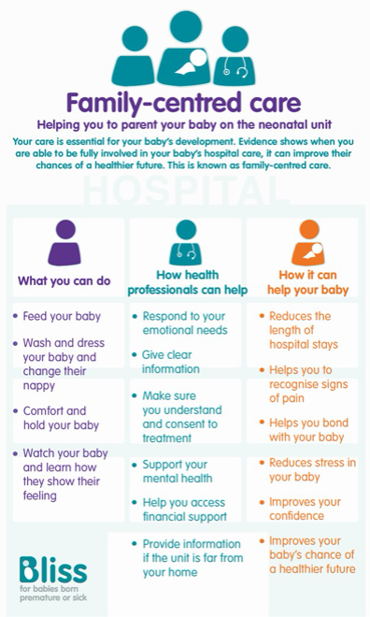

Approaches which influence communication with CYP and family
Child-centred care
www.bliss.org.uk
Notes:
There are different approaches to caring for children and young people (CYP); Family-Centred Care (FCC) and Child-Centred Care (CCC). It is likely that you have already adopted principles of both in your current practice, although it is worth acknowledging the theory and principles.
FCC was developed in the mid-20th century after the increasing recognition of the influence family members had on CYP’s health and wellbeing. FCC recognises all the family members as being care recipients, and embraces an equal partnership between the HCP and parent (Carter el al. 2014). FCC has clear advantages; collaboration between HCPs and the family allows a more flexible approach to decision-making which takes account of strengths, weakness, values and abilities of all involved. Kennedy (2012) acknowledges how CYP perceived FCC; they saw themselves as having a different set of rules to their parents and HCPs, and were unsure of how to engage in discussions with adults.
Researchers have proposed CCC as an alternate approach. CCC identifies the child or young person as central to their own care, and acknowledges their rights, their competence and their voice. The difference between FCC and CCC is one of emphasis and reflects the extent to which children’s concerns are evidenced in the organisation of care (Carter el al. 2014).
How this influences our practice?
Triadic communication between HCP, parent and CYP can be difficult to navigate. Paediatric trainees need to learn to meet the needs of both CYP and their parents by adopting both models of care depending on what the situation calls for.
It is also important to consider the need for an interpreter when communicating with CYP and their families as we live in a culturally diverse society. If time does not allow for an interpreter to be booked in person, telephone services can be used. This can be vital for the sharing and understanding of information between patients and clinicians.
Assessment Links: CbD, Mini-CEX, DOPs, 360 feedback
References:
Carter, B., Bray, L., Dickinson, A., Edwards, M., & Ford, K. (2014). Child-centred nursing: Promoting critical thinking. London: Sage publications
GMC (2007) 0-18 years: Guidance for all doctors. [Online]. Available from: doi:ISBN: 978-0-901458-29-.
Pritchard Kennedy, A. (2012) Systematic ethnography of school-age children with bleeding disorders and other chronic illnesses: exploring children’s perceptions of partnership roles in family-centred care of their chronic illness. Child: care, health and development. [Online] 38 (6), 863–869. Available from: doi:https://dx.doi.org/10.1111/j.1365-2214.2011.01310.x.
IMAGES from https://www.bliss.org.uk

Slide 10
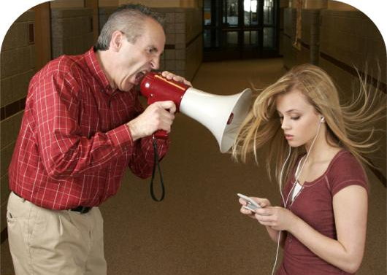
Communicating with adolescents
Notes:
Adolescents are a particularly vulnerable patient group that require an individualised approach to care as they mature and gain independence. Those working with YP describe challenges in communicating with this population, although RCTs have confirmed that communications skills training can improve practice with sustainability (Sanci et al. 2000). Paediatricians require communication strategies to meet the dynamic needs of adolescents.
Key issues when communicating with YP have been identified by White & Viner (2012):
The young person should be central in the communication, with discussions primarily focused on him/her: Direct introductions to the YP and ask who have they brought with them today. Ask for their permission to speak to their parents.
The young person should be offered time alone with the clinician: Explain that it is routine to spend some time alone at the end of the consultation. This helps YP to disclosure health concerns that they haven’t mentioned to their parents, or maltreatment/ abuse. Protective parents may object to this. It is worth seeing the parents alone before seeing the YP to discuss the communication strategies, any sensitive matters that they have been banned from speaking about.
Conditional confidentiality should be discussed, and does not reduce rates of disclosure: Assurance of confidentiality, and describing scenarios for breaching, increases the YP’s willingness to disclose sensitive information.
Ambivalence is normal – techniques can be learnt to help the young person resolve ambivalence and change behaviour
A psychosocial history is a key part of the adolescent consultation, and should include resilience factors as well as risk: HEADSS (or HEEADSSS)- see next slide
Dooukrou & Segal (2017) describe the importance of the psychosocial history, at every opportunity, when in contact with this patient group. Excluding infancy, adolescence has the highest mortality rate- boys are greater than girls (15-24) and the causes are often preventable- such as risk taking behaviours and suicide. Paediatricians are in a prime position to build a rapport with YP and may be the first to identify mental health problems or sexual exploitation.
Assessment Links: Mini-CEX, DOPs, CbD, 360 feedback
Resources:
The Adolescent Health Programme (AHP) is an e-learning programme for all healthcare professionals working with young people. It is the third programme in the Healthy Child Programme 0-18 series of e-learning resources, following the Healthy Child Programme and Healthy School Child Programme. Available at www.e-lfh.org.uk.
The Young People’s Special Interest Group are an association of the RCPCH, whose aim is to raise the profile of young people’s health and promote the development of high quality health services in the UK. Access their website at http://www.yphsig.org.uk/home and consider becoming a member. Explore how to frame your HEEADSSS questions and relevance to resilience using the app: https://app.appinstitute.com/heeadsss
References:
Doukrou, M. & Segal, T.Y. (2018) Fifteen-minute consultation: Communicating with young people - How to use HEEADSSS, a psychosocial interview for adolescents. Archives of Disease in Childhood: Education and Practice Edition. [Online] 103 (1), 15–19. Available from: doi:10.1136/archdischild-2016-311553.
Sanci, A., Coffey, C., FCM, V., Carr-Gregg, M., et al. (2000) Evaluation of the effectiveness of an educational intervention for general practitioners in adolescent health care: randomised controlled trial...including commentary by Ker J. BMJ (Clinical research ed.). [Online] 320 (7229), 224–230. Available from: doi:10.1136/bmj.320.7229.224.
White, B. & Viner, R.M. (2012) Improving communication with adolescents. Archives of Disease in Childhood: Education and Practice Edition. [Online] 97 (3), 93–97. Available from: doi:10.1136/edpract-2011-300797.

Slide 11
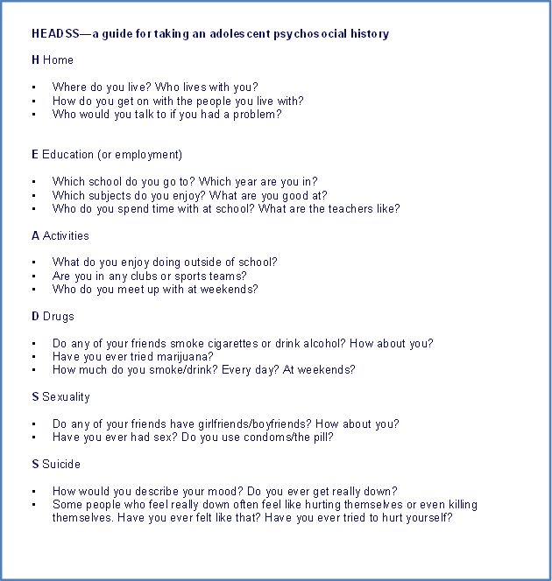
Getting into adolescent HEADSS
Notes:
HEADSS (Home, Education/Employment, Activities, Drugs, Sexuality, Suicide) or HEEADSSS (Home(sleep), Education/Employment, Eating, Activities (screens), Drugs, Sexuality, Suicide, Safety) offers a useful framework to help paediatrician’s talk to adolescents about important issues such as risk-taking behaviours that may be relevant to them but difficult to bring up (Payne et al 2005).
The CRAFFT questionnaire is another useful mnemonic, as two or more yes answers suggest high risk of a serious substance-use problem or a substance-use disorder.
Questions are pitched as follows:
► C—Have you ever ridden in a Car driven by someone that was high or had been using drugs or alcohol?
► R—Do you ever use alcohol or drugs to Relax, feel better about yourself?
► A—Do you ever use drugs or alcohol when you are Alone?
► F—Do you Forget things you did while using drugs or alcohol?
► F—Do your Family and Friends ever tell you that you should cut down your drinking or drug usage?
► T—Have you ever gotten into Trouble while using drugs or alcohol?
References:
Doukrou, M. & Segal, T.Y. (2018) Fifteen-minute consultation: Communicating with young people - How to use HEEADSSS, a psychosocial interview for adolescents. Archives of Disease in Childhood: Education and Practice Edition. [Online] 103 (1), 15–19. Available from: doi:10.1136/archdischild-2016-311553.
Payne D, Martin C, Viner R, et al.Adolescent medicine in paediatric practice. Archives of Disease in Childhood 2005;90:1133-1137

Slide 12
Effective Communication
Should result in shared mental model
Requires flattening of hierarchies
Is essential for effective teamwork & patient safety
Helped by use of “critical language” and standardised communication tools
Notes:
Effective communication requires an environment in which there are no hierarchies and individuals can speak up. A plan communicated effectively should result in a shared mental model with the patient/families/carers/healthcare team. Effective communication results in better situational awareness and improved team-working. The use of standardised communication tools such as SBAR and CUSS (discussed later) and “critical language” can be very helpful when communicating in stressful situations and help mitigate human factors. Above all, effective communication is essential for patient safety.

Slide 13
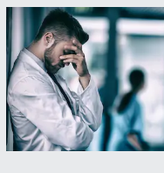
Techniques for managing emotions during difficult conversations
Self-care
Preparatory and relational skills
Empathic presence
Team approach
Professional identity
Notes:
Paediatric trainees deal with difficult situations on a daily basis: postnatal discussions, neonatal sepsis, end of life decisions or breaking bad news. Luff et al (2016) examined strategies employed by healthcare professionals (HCPs) to manage their emotions during difficult healthcare consultations. 126 participants were involved in a communication skills workshop and completed a self-reported questionnaire in response to realistic enactments of difficult healthcare conversations.
The techniques reported by HCPs were:
Self-care (51%): Pausing, being mindful, breathing deeply, venting, exercise.
Preparatory and relational skills (29%): Considering before hand what the family need from me, slowing down, allowing silence, gauging the situation.
Empathic presence (28%): Put yourself in their shoes, consider their journey, remember you are here for them.
Team approach (26%): Talking with colleagues before and after for advice and feedback, or taking colleagues with you.
Professional identity (20%): Acknowledging your role as a professional, including standards, responsibilities, values and limitations. Separating professional-self with personal-self to maintain emotional equilibrium.
Assessment Links: CbD, safeguarding CbD, 360 feedback
References:
Luff, D., Martin, E.B., Mills, K., Mazzola, N.M., et al. (2016) Clinicians’ strategies for managing their emotions during difficult healthcare conversations. Patient Education and Counseling. [Online] 99 (9), 1461–1466. Available from: doi:10.1016/j.pec.2016.06.017.
Image = www.pixaby.com

Slide 14

Poor interprofessional communication in paediatrics contributes to 44% of adverse outcomes (Hain et al., 2007)
Notes:
Effective interprofessional communication is essential in paediatric practice, especially when part of a multi-disciplinary team, managing complex patients or managing an acute scenario. Poor communication between HCPs is a contributing factor leading to clinical errors and adverse outcomes for patients including death (Hain et al., 2007). Nurses, doctors and other HCP’s have been taught to communicate in different ways therefore we must be mindful of this (Leonard et al, 2004).
Recommendations for effective communication (Borrott et al., 2017; Davies, 2015; General Medical Council, 2013):
Introductions: State your full name and grade, if not already known, at the start of the conversation.
Mode: It is best to communicate face to face whenever possible rather than via third party to minimise miscommunication. Written entries are important and can be referred to for clarification. Written communication should not replace verbal communication, as notes may not be reviewed until after the intended or un-intended action was due to occur.
Purpose: Be explicit in the purpose of the communication (e.g. I have a referral or I would like your opinion on this case). If you are the recipient of the information, ask how you can assist rather than assuming (e.g. How can I help, would you like me to assess the patient or talk to them about the prognosis?)
Specifics: Avoid tentative language such as just, maybe, if you have time, sort of. Instructions or requests containing tentative language can inadvertently conflict with the aim of the request, especially in regards to the urgency. For example, ‘sorry to bother you, I was wondering if you were free could you pop down to the xxx ward to see this patient’ could be replaced with ‘sorry to bother you, I am on xxx ward now, I am concerned about this patient. Could you review him urgently for me please’. Direct communication styles, framed appropriately can be delivered in a polite and respectful manner.
Clarification: Was that yesterday’s U&E result or today’s? What BP are we aiming for? Sorry, I don’t know that consultant, what is his name... will he be on-site? Clarification is valuable when management plans are devised.
Shared decision-making: asking a colleague ‘what do you think?’ can create an alternative approach.
Check-back: The recipient repeats back what they understood. This allows confirmation, further clarification, improved retention of information and action points to be identified.
Embrace educational opportunities: It’s important to ask why? Understanding why the patient needs this urgently, or why there are concerns will allow effective teamworking and enhance knowledge.
Transferring care: Share all relevant information with colleagues, in a readable and well organised form and include conclusions and management plans. Be sure that you colleague has accepted the specified role in the patient’s care and document this in the notes.
Assessment Links: CbD, Mini-CEX, 360 feedback
References:
Borrott, N., Kinney, S., Newall, F., Williams, A., et al. (2017) Medication communication between nurses and doctors for paediatric acute care: An ethnographic study. Journal of Clinical Nursing. [Online] 26 (13–14), 1978–1992. Available from: doi:10.1111/jocn.13606.
Davies, M. (2015) Communicating with colleagues. BMJ. 350.
Hain, P.D., Pichert, J.W., Hickson, G.B., Bledsoe, S.H., et al. (2007) Using risk management files to identify and address causative factors associated with adverse events in pediatrics. Therapeutics & Clinical Risk Management. [Online] 3 (4), 625. Available from: http://queens.ezp1.qub.ac.uk/login?url=http://search.ebscohost.com/login.aspx?direct=true&db=edb&AN=84959334&site=eds-live&scope=site.
General Medical Council (2013) Good medical practice. [Online]. pp.1–40. Available from: doi:10.1136/bmj.327.7425.1213. https://www.gmc-uk.org/ethical-guidance/ethical-guidance-for-doctors/good-medical-practice
Leonard M, Graham S, Bonacum D. The human factor: the critical importance of effective teamwork and communication in providing safe care
BMJ Quality & Safety 2004;13:i85-i90

Slide 15
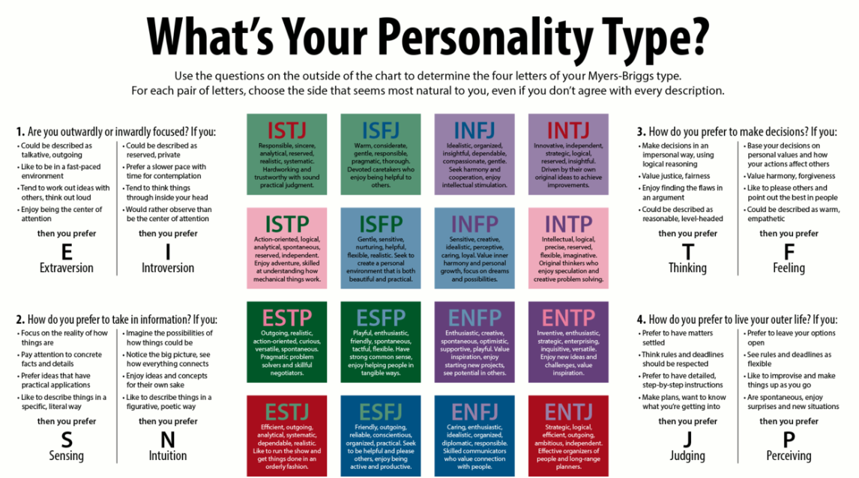
www.myersbriggs.org/my-mbti-personality-type/my-mbti-results/
Notes:
We are not homogenous beings. Everyone has their own natural way of working and interacting. What personality type are you? By identifying your personality type you can consider your strengths and natural communication approaches. If you are communicating with someone of a different styles, consider how you could adapt your style to improve communication.
Communication style reports are available which describe your strengths and tips for communicating with your opposite style.
For example, tips for extroverts communicating with introverts:
• Practice active listening skills
• Think before speaking or let others know you are thinking out loud
• Respect need for privacy, build trust, and be sure to respect confidentiality • Choose a time and place to communicate with a minimum of distraction
• Speak slowly and calmly (without being condescending)
• Pause and wait for a response; don’t jump in to fill silence, especially with small talk
• Don’t come across as imposing or demanding of an immediate response • Provide information ahead of time and allow time and space for processing
• Focus on one topic and stay on topic
• Summarize and share your final thoughts and direction
Assessment link: CbD, Mini-CEX, 360 feedback
References:
The Myers-Briggs Foundation, accessed [online] 30.1.2019, https://www.myersbriggs.org/my-mbti-personality-type/my-mbti-results/
Sample, J., Dunning, D. & Sample, J. (2016) Communication style report.

Slide 16
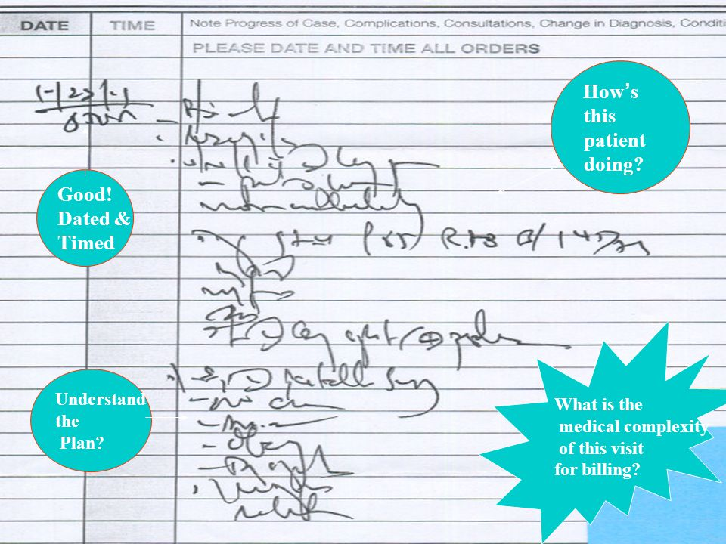
Written communication
Notes:
Writing in clinical notes
At least 3 identifiable patient criteria
Date, time (24 hr), your name (caps), grade & GMC No.
Clear, accurate & legible!!
Record immediately or asap afterwards
Include assessments, decisions, actions, conversations, information given, results, treatments and concerns. Review & changes to IVF management.
State whether confidential information has been shared
Clinical notes can be used in court, therefore selections should not be deleted or replaced.
CYP and parents have the right to see their notes
Extra diligence in record keeping is required for safeguarding cases, which may include body diagrams and photographs
At some point, each one of us will expect to be required to write a coroner’s report. This requires a different type of writing style than most of us are used to. A corner’s report is a factual account of events, observations, findings and discussions, written chronologically and in first person.
Example: instead of writing, 'The patient was examined again later in the day', it's more helpful to say, 'I remember asking my registrar, Dr Jane Smith, to examine the patient again later on the same day, and according to the notes she did so.’ In the opening paragraph, state your full name, grade, GMC number and background. State the post you held at that time and your shift that day. Use dates and times. Avoid jargon and abbreviations. You may refer to others using their full name and professional status, while explaining factually what they did and what their conclusion was. You should not make an impression on others clinical performance or give an opinion. Seek assistance from your consultant colleague and relevant trust personnel. Uphold Data protection regulations when sending documents.
Assessment Links: CbD, DOC, 360 feedback
Reference List:
Keeping records, GMC, webpage https://www.gmc-uk.org/ethical-guidance/ethical-guidance-for-doctors/protecting-children-and-young-people/keeping-records
Writing a report for the corner, MDU, webpage https://www.themdu.com/guidance-and-advice/guides/writing-a-report-for-the-coroner

Slide 17
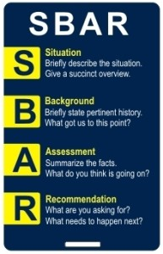
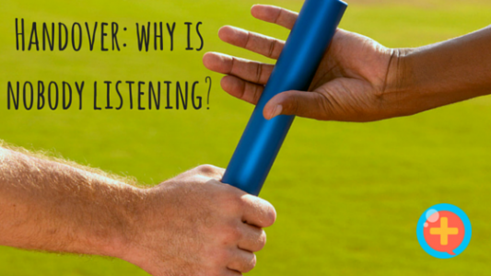
Safe Handover & Debriefing
A structured handover, written and verbal, focussed on key patient safety messages, helps the paediatric team to improve patient care & safety
Notes:
An effective handover in clinical practice is essential to ensure that all points are raised (safety, managerial, administrative & safeguarding) in a standardised manner that is familiar to all that attend. A vast amount of information can be delivered in a small amount of time supported by written documentation. SBAR (situation, background, assessment, recommendation) and CHAP (clinical picture, history, assessment, plan) have been used in clinical paediatric settings. SBAR has also been adapted to include I-SBAR (identify yourself and patient) and ISBAR-D (Decision) which are perhaps more complete. Often these tools are used during “huddles” or “board rounds” after ward rounds or in Emergency Departments or indeed may provide structure for telephone conversations with a registrar/Consultant on call.
ATMIST (age, time, mechanism, injury, signs, treatments) is useful in emergency care settings for trauma and injuries. These approaches have been shown to be efficient and sustainable, increasing the quality of the handover delivered while raising confidence and improving patient safety.
Debriefing after incidents (e.g. acute deterioration, trauma call, neonatal/paediatric resuscitation) is essential to share information and evaluate what happened. It provides an opportunity to identify learning points and allow staff to process the emotional impact of the incident. The process can be really beneficial for staff involved if communication is effective and appropriately sensitive.
Useful resources:
http://www.stemlynsblog.org/good-to-talk-debrief-in-the-emergency-department/
https://www.paediatricfoam.com/2017/01/the-hot-debrief/
Eppich WJ, Mullan PC, Brett-Fleegler M, Cheng A. “Let’s Talk About It”: Translating Lessons From Health Care Simulation to Clinical Event Debriefings and Coaching Conversations. Clinical Pediatric Emergency Medicine. 2016 Sep 1;17(3):200-11.
Assessment Link: Handover Assessment Tool (HAT), 360 feedback
Reference List:
Kulkami, A., Shetty, S. and Damda, F. (2014) ‘G443(p) CHAPS handover tool in a paediatric setting’, Archives of disease in childhood, 99(Suppl 1), p. 2014.
NHS Modernisation Agency, NHS National Patient Safety Agency and British Medical Association (2004) ‘Safe handover: safe patients. Guidance on clinical handover for clinicians and managers’, p. 38. Available at: http://www.bma.org.uk/images/safehandover_tcm41-20983.pdf.
Radford, A. et al. (2017) ‘G365(P) Improving paediatric handover: SBAR, safety, unit management and workload’, Archives of Disease and Child Health, 102, pp. A143-144.
Thompson, N. et al. (2016) ‘G537 A quality improvement project to address ineffective neonatal handover in a district general hospital’, Archives of Disease in Childhood, 101(Suppl 1), pp. A318–A319. doi: 10.1136/archdischild-2016-310863.524.

Slide 18
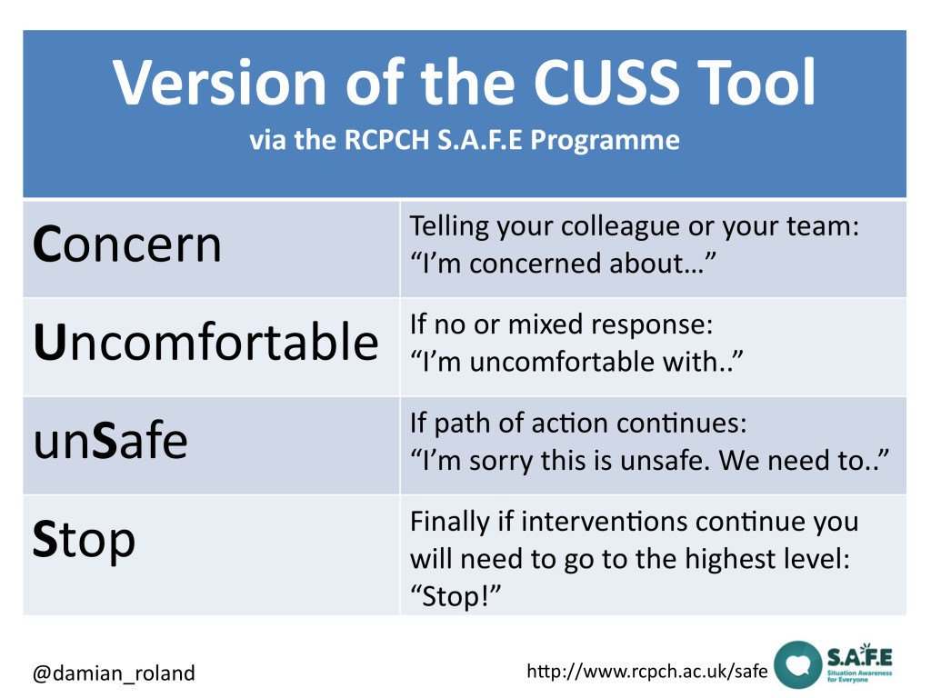
Don’t be afraid to use
“Critical Language”
Notes:
CUSS (I’m…Concerned, Uncomfortable, Unsafe, Stop) relies on graded assertiveness when communicating and is a particularly useful way of using critical language to express concern during an intervention or process where there is concern about patient safety. At each stage, the reasons behind the concern should be verbalised. If a concern is not being listened to initially it equips you with useful terms to escalate the concern in a way that is clearly understood by all. The use of critical language should prompt an individual or team to take a step back and reconsider their approach or plan.
(Derived from CUS programme at United Airlines)
The use of standardised communication tools helps to mitigate human factors by providing structure to communication and therefore aids cognitive offloading. We should be mindful that there is a limitation to our memory and we are susceptible to distractions or interruptions which may compromise patient safety.

Slide 19
How can the Communication Domain be assessed?
CBD
Mini-CEX
DOC
LEADER
ACAT
Safeguarding CBD
HAT
ePortfolio
MSF
CCF
START
DOPS
Trainer report
MRCPCH Clinical
Notes:
Each of the above can be used to demonstrate progress and achievement of the appropriate levels in the Communication Domain of the Progress curriculum (Domain 2).

Slide 20


Useful training and resources
Situation Awareness for Everyone (SAFE) toolkit
www.rcpch.ac.uk/resources/situation-awareness-everyone-safe-toolkit-introduction
RCPCH course: Statement and report writing
RCPCH e-learning: Information sharing matters
Me first communication with Children & YP Centred Communication Masterclass,
17th May 2019, www.mefirst.org.uk

Slide 21
Acknowledgements
This slide pack was created by:
Dr Gail Davison, Research Fellow at Royal Belfast Hospital for Sick Children and Queen’s University Belfast, www.researchgate.net/profile/Gail_Davison gdavison05@qub.ac.uk
Dr Julie-Ann Collins, ST6 Paediatric Emergency Medicine at Royal Belfast Hospital for Sick Children & RCPCH NI Rep
With support from:
Dr Dougal Hargreaves, Honorary Consultant Paediatrician at UCL Hospital, www.nuffieldtrust.org.uk/person/dougal-Hargreaves d.hargreaves@imperial.ac.uk
Jessie McCulloch, Lead Practice Educator at Me first and Commercial Education, GOSH for Children NHS Foundation Trust Jessie.McCulloch@gosh.nhs.uk
www.mefirst.org.uk

