Slide 1
Domain 10:
Education and Training

Slide 2
Curriculum overview
Structural changes
  Reduction in the overall indicative length of training from eight to seven years.
Change to two training levels
  Core Level Paediatrics (Year 1-4)
  Specialty Level Paediatrics (year 5-7)
Changes with a view to improving flexibility:
Embedding capability rather than time-based training
Removal of the requirement to do six-month blocks (e.g., neonates, community child health).
Mapping of similarities between sub-specialties so trainees can change pathway and count capabilities already achieved.
Promotion of OOP (out of programme) opportunities.

Slide 3
Core Capabilities in
Education and Training
This domain requires trainees to develop skills that enable them to teach patients, families, carers and other health and social care professionals.
Trainees are required to develop skills that enable them to provide safe supervision and training activities for those in junior positions and for other health and social care professionals. This is achieved through the creation of effective learning opportunities.

Slide 4
Core Level –
Curriculum Learning Outcome 10
Core Learning outcome | Key capabilities
Plans and delivers teaching and learning activities to a wide range of audiences and provides appropriate feedback to others. | Demonstrates the ability to plan and deliver teaching in a range of clinical and non-clinical contexts. Shows the ability to adapt their teaching methods to the different learning needs of individual team members. Provides evidence of obtaining feedback on teaching delivered by them; reflects on and learns from this feedback. Provides appropriate feedback to others.

Slide 5
Specialty Capabilities in Education and Training
Trainees will demonstrate the knowledge, skills and attitude to provide highly effective teaching, learning opportunities, supervision, assessment and mentorship in the paediatric healthcare setting. They will also evaluate the impact of teaching and make adjustments accordingly

Slide 6
Specialty Level –
Curriculum Learning Outcome 1
Specialty learning outcome | Key capabilities
Demonstrates the required knowledge, skills and attitudes to provide appropriate teaching, learning opportunities, supervision, assessment and mentorship in the paediatric healthcare setting. | Evaluates teaching practice in a range of contexts using a variety of methods. Effectively uses supervised learning events (SLEs) on colleagues to develop and facilitate their learning. Facilitates children, young people and their families’ understanding of their condition(s).

Slide 7
Underpinning knowledge
Education and Training
Effective learning environments
Teaching mentoring and supervision
Assessment and feedback
Patient and carer education

Slide 8
Learning and Teaching
(Bloom’s revised Taxonomy – reproduced)
Creating
Generating new ideas, products, or ways of viewing things
Designing, constructing, planning, producing, inventing
Evaluating
Justifying a decision or course of action
Checking, hypothesising, critiquing, experimenting, judging
Analysing
Breaking information into parts to explore understandings and relationships
Comparing, organising, deconstructing, interrogating, finding
Applying
Using information in another familiar situation
Implementing, carrying out, using, executing
Understanding
Explaining ideas or concepts
Interpreting, summarising, paraphrasing, classifying, explaining
Remembering
Recalling information
Recognising, listing, describing, retrieving, naming, finding
Higher-order thinking
Over time, a learner moves from lower to higher-order thinking as they gain expertise. This applies to all clinical skills, including education.

Slide 9
Teaching methods
Teaching Method | Main Process | Role of the teacher | Principal author(s)
Didactic | Telling | Pass on knowledge | Many
Socratic | Questioning | Facilitating learning through awareness Raising questions | Neighbour
Heuristic | Encourage self / discovery learning | Promote learner autonomy and self-directed learning | Kolb Knowles
Counselling | Explore feelings and assumptions | Encourage self awareness / self discovery and reflective practice by using discussion, challenging assumptions and explorations of feelings | Schön

Slide 10
Effective Learning Environment
Self-actualisation
Self-fulfilment needs
Achieving one’s full potential, including creative activities
Psychological needs
Esteem needs:
prestige and feeling of accomplishment
Belongingness and love needs:
intimate relationships, friends
basic needs
Safety needs:
security, safety
Psychological needs:
food, water, warmth, rest
To learn effectively we need a suitable environment. It is the responsibility of the clinical educator to create that space.

Slide 11
Supervision
Vision – implies seeing
Supervision – over-seeing, looking over someone’s shoulder
Super – also in sense of outstanding or special, helping someone to extend their professional skills and understanding
Halpern and McKimm .B J Hosp Med 2009;70:226-9

Slide 12
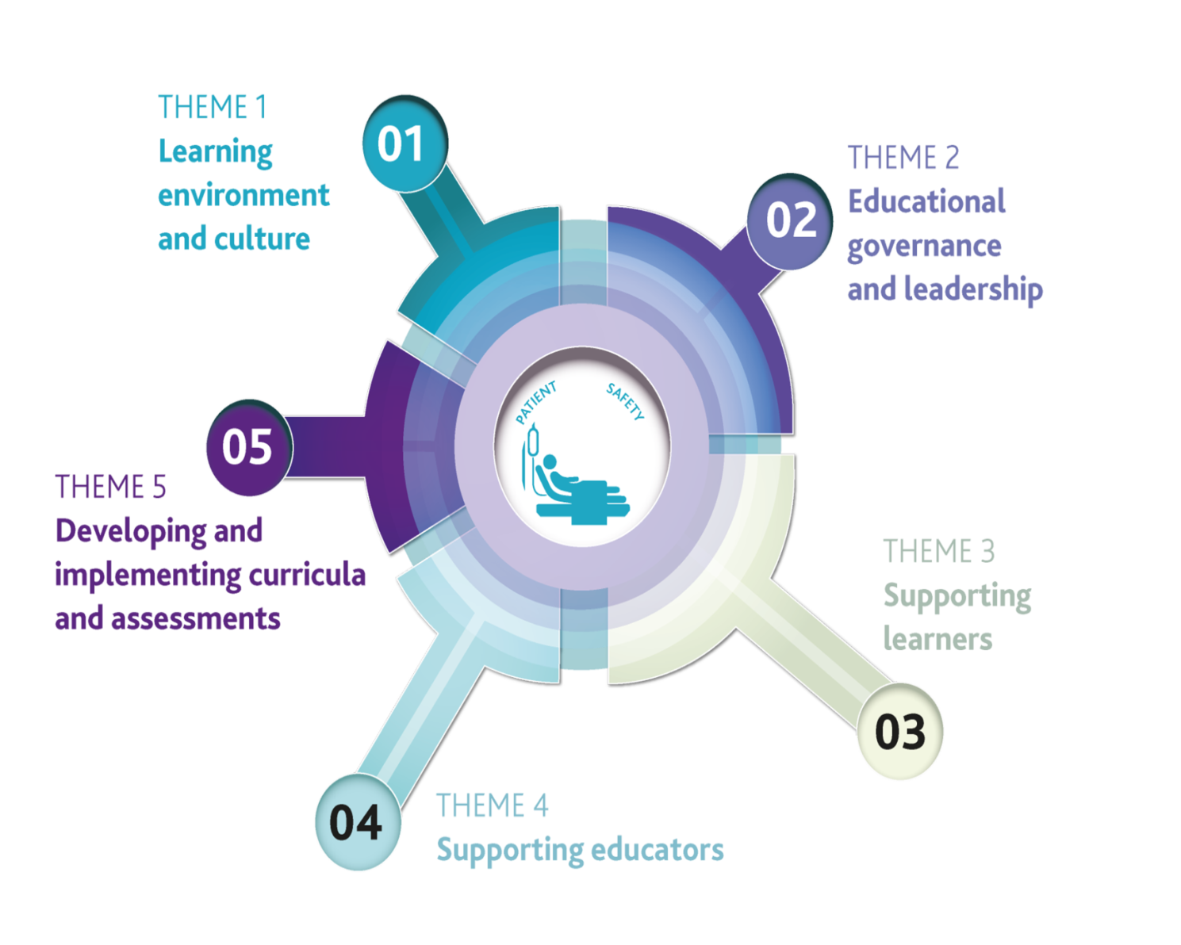
Framework for GMC supervision standards
http://www.gmc-uk.org/education/standards.asp

Slide 13
Mentoring
“Mentoring is the process by which an experienced, highly regarded, empathic person (the mentor) guides another individual (the mentee) in the development and re-examination of their own ideas, learning, and personal and professional development.”
Standing Committee on Postgraduate Medical and Dental Education (1998) ‘Supporting doctors and dentists at work: an enquiry into mentoring’.

Slide 14
A Mentor is…
“A more experienced individual willing to share knowledge with someone less experienced in a relationship of mutual trust" - David Clutterbuck.
A trusted counsellor or guide. Normally a senior person to the associate.
A coach, motivator, and role model.

Slide 15
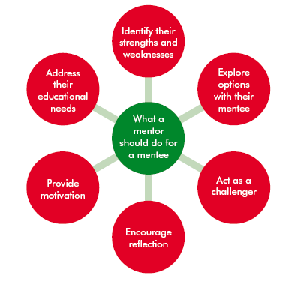
Mentoring Skills
Trust
Openness
Understanding
Confidentiality
Honesty

Slide 16
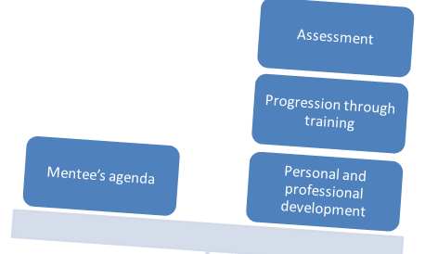
What’s the difference between a mentor and a supervisor?

Slide 17
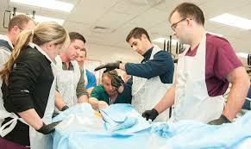
Examples from the Curriculum
At level 1
The Trainee is asked by their Supervisor to teach at the weekly departmental journal club.
They prepare their journal article and some associated teaching materials to share with colleagues. Before the day they are able to discuss the session with their Supervisor.
The Supervisor observes the Trainee’s teaching and provides feedback using a CBD.
Notes:
https://www.google.co.uk/url?sa=i&rct=j&q=&esrc=s&source=images&cd=&cad=rja&uact=8&ved=2ahUKEwi4rsfcopDgAhXjAGMBHVlQCSsQjB16BAgBEAQ&url=https%3A%2F%2Fhealth.mil%2FNews%2FArticles%2F2017%2F02%2F16%2FCourse-preps-Army-doctors-medics-for-deployment&psig=AOvVaw0mrSVBTHmB4wiShwK1z2i1&ust=1548757706891416

Slide 18
Examples from the Curriculum
At level 2
The Ward Sister and the Trainee have been discussing the difficulties of winter in acute paediatrics.
This leads the Sister to ask the Trainee to deliver a teaching session on respiratory illnesses in children. The audience will be nursing staff, medical students, allied health professionals and a physician's assistant.
The Trainee plans the session and discusses it with their Supervisor. They deliver the session at the agreed time.
The Supervisor is able to observe the trainee and provide feedback following the session.
Notes:
Photo from unsplash, Marco W

Slide 19
Examples from the Curriculum
At level 3
The Trainee notices that a number of parents on the neonatal unit are anxious about their babies being discharged home soon.
The Trainee plans and delivers a session on the neonatal unit for parents, about practical tips for caring for a premature baby, and how to spot an unwell child.
Afterwards, the Trainee collects written evaluations from parents about what they liked, and what else they would like to know.
The Trainee’s supervisor discusses the session with them afterwards and completes a Leader CBD detailing the main points of their discussion.

Slide 20
Learning and assessment
Workplace based assessments (WBA) are tools to help facilitate and evidence learning in the workplace.
Used well, the Kaizen/RISR assessments can help provide structure to clinical supervision.
Level 2 and 3 Trainees should become proficient at using the assessment tools to provide clear and constructive feedback to peers and colleagues.

Slide 21
Evidencing clinical education
Assessments can also be helpful in evaluating and evidencing your own teaching.
There is no single Kaizen/RISR assessment tool to use for teaching evaluation.
If you want a large group of learners to provide an evaluation of your teaching, you can collect this separately using a tool specific to your session and upload it to your e-portfolio.
If you want feedback from a supervisor or peer, you could consider:
  A CEX for directly observed teaching events.
  A CBD for teaching you have discussed.
  A Leader CBD for teaching you have designed and lead.
  Using the Developmental Log to record a face-to-face discussion.

Slide 22
Push yourself
Medical education is an area in which trainees regularly make significant contributions to healthcare.
These slides briefly address the capabilities all paediatric trainees should aim to be proficient in.
Some trainees will want to pursue this role further and take on formal clinical education responsibilities.
If you have an interest in medical education, consider a postgraduate medical education qualification, or for practical tips, check out the RCPCH Paediatric Educators Special Interest Group website.

Slide 23


Useful training and resources
Mentoring skills courses
Effective Educational Supervision courses
Paediatric Educators Special Interest Group
The Association of Medical Education in Europe
Association for the Study of Medical Education
Association for Simulated Practice in Healthcare
R Ghataoura, V Acharya. Selecting the right postgraduate course in medical education. BMJ 2016; 352 https://doi.org/10.1136/bmj.h6883
RCPCH Progress - Supervisor & Trainee video - https://www.youtube.com/watch?v=_brAqG_KWWA

