Slide 1
Domain 5:
Health Promotion & Illness Prevention

Slide 2
Curriculum overview
Structural changes
  Reduction in the overall indicative length of training from eight to seven years.
Change to two training levels
  Core Level Paediatrics (Year 1-4)
  Specialty Level Paediatrics (year 5-7)
Changes with a view to improving flexibility:
Embedding capability rather than time-based training
Removal of the requirement to do six-month blocks (e.g., neonates, community child health).
Mapping of similarities between sub-specialties so trainees can change pathway and count capabilities already achieved.
Promotion of OOP (out of programme) opportunities.

Slide 3
Core Level –
Curriculum Learning Outcome 5
This domain includes all aspects of health promotion, be that with individuals, groups or populations. Global health and sustainable medicine are at the forefront of Paediatrics.
The trainee must become increasingly proficient in considering the baby, child and young person as a whole, taking into account those wider aspects of cultural, economic, social and educational perspectives, optimising opportunities to promote healthy lifestyle education.
Core Learning outcome | Key capabilities
Promotes healthy behaviour in conversations with children, young people and their families/carers, from early years through to adulthood; taking into account the potential impact of cultural, social, religious and economic factors on the physical and mental health of children and families. | Recognises the potential impact but also limitations of health promotion advice. Applies knowledge of the factors which contribute to child health inequalities and the consequences of those inequalities in terms of disability, life expectancy and health economics. Anticipates contextual factors (socioeconomic, cultural, psychological) which constrain the ability to make “healthy choices”. Interprets the impact of environmental, economic, global and cultural contexts on health promotion and physical and mental health illness prevention. Interacts effectively with children, young people and their families from a broad range of socioeconomic and cultural backgrounds, appropriately using translated materials and interpreters, if required.

Slide 4
Specialty Level –
Curriculum Learning Outcome 5
Specialty learning outcome | Key capabilities
Works with the wider healthcare community promoting wellbeing, physical and mental health to improve the health of babies, children and young people.. | Understand the impact of wider economic, cultural and social factors which impact on mental and physical health at a population level. Demonstrates leadership and understanding of the systems that enable clinicians to analyse data relating to the patients under their care. Utilises local, national and international health information in order to advocate for systems and policies which promote health and reduce inequalities. Understands contextual barriers to accessing healthcare and adapts practice to reduce these. Demonstrates leadership in health promotion by undertaking educational and/or quality improvement activity in this area across professional groups. Evaluates the way that patients and families use the health system and adapts their practice to encourage self-management and early engagement. Shows involvement in the process of anticipation, prevention, preparation, detection, response (contain, delay, and mitigate), communication, research and control of an epidemic in order that the population health impacts are minimised.

Slide 5
Underpinning knowledge
Health promotion & illness prevention
Encourage healthy behaviours at all opportunities e.g. smoking cessation, healthy diet, exercise, immunisations
Knowledge of the wider social determinants of health e.g. cultural, religious, economic factors.
With individuals, with localities, with populations including global health
Relationships between culture, economy, harms and risk with good health.

Slide 6


Useful training and resources
RCPCH clinical course: ‘How to manage’ Childhood obesity.
RCPCH Healthy Child Programme – eLearning
RCPCH Healthy development in young people (substance misuse) – eLearning
Useful reading: https://doi.org/10.1016/j.paed.2010.01.006
Child public health and social paediatrics. Two-day course at Imperial College London, 20-21 May 2019
Notes:
Add in any local training or resources

Slide 7
Health Promotion
The process of enabling people to increase control over and to improve their health.
Paediatricians are in an influential position to promote children’s health at an individual or hospital level, as well as in the wider community

Slide 8
Healthy Child Programme (HCP
A framework in England to promote health in children which starts antenatally to age 19y
0-5y delivered by health visitor
5-19y delivered by school nurse
Key elements:
  Parenting support and education
  Protect children from serious disease through routine childhood immunisations.
  Early detection and treatment of illness and developmental impairments.
  Reduce obesity
  Encourage vitamin drops for all children Scotland, 5y.
In Scotland, please refer to the ‘Health for All Children’ (known as HALL 4) document from the Scottish Government.
In Wales, please refer to ‘An overview of the Healthy Child Wales Programme’ by the Welsh Government

Slide 9
Health promotion & illness prevention in daily practice
Encourage use of safety devices e.g. seatbelts, bicycle helmets, childproof containers for medicines / household poisons (liquitabs).
Encourage immunisations.
Encourage healthy diet and exercise.
Encourage and support young people to quit smoking using the “3As”:
  Ask if they smoke
  Advise them about stopping and NHS stop smoking services.
  Act by offering a referral to local services.
  Act by offering a referral to local services.

Slide 10
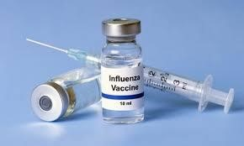
Examples from the Curriculum:
Clinical Lead; Dr Christine Pierce
Level 1:
theepochtimes.com
•
Giving advice on vaccination. This can be
done in baby clinics or in an acute setting.
.
•
Taking a vaccination history and ensuring
that the carers are aware of the vaccination
schedule
•
Giving advice on healthy eating in clinic.
This can occur again around taking a
feeding history
•
Giving advice around not smoking
particularly with carers of an asthmatic
child.

Slide 11
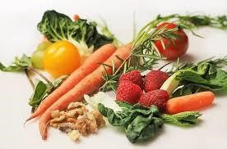
Examples from the Curriculum:
Clinical Lead; Dr Christine Pierce
Level 2
The level 2 trainee takes this a step further by taking into account cultural, social religious and economic factors.
In vaccination particular cultural and social views may influence the carers engagement with vaccination programs

Slide 12
Examples from the Curriculum:
Clinical Lead; Dr Christine Pierce
Engagement with HPV vaccination is an example of this.
In healthy eating religious, social and economic factors may influence this e.g. vegetarians, breast feeding etc

Slide 13

Examples from the Curriculum:
Clinical Lead; Dr Christine Pierce
Level 3
The trainee may take this further by doing an audit or writing a guideline, e.g.
Vaccination of children with sickle cell disease/ incidence of pneumococcal disease or meningococcal before and after the change in vaccination program.
Incidence of obesity/incidence of diabetes.

Slide 14
Global Health: Key Facts
Each year, nearly 6 million children die before the age of five
One million newborn babies die on their first day of life
Each day 17,000 children die of preventable causes
Most of these deaths occur in Sub-Saharan Africa and in South Asia, in countries with the lowest numbers of health workers and medical schools per population
Malnutrition accounts for nearly half of these deaths
Nearly 250 million children globally don’t reach their developmental potential because of poverty and stunting
Child mortality rates in the UK are amongst the highest in
Western Europe and almost twice as high as in Sweden

Slide 15
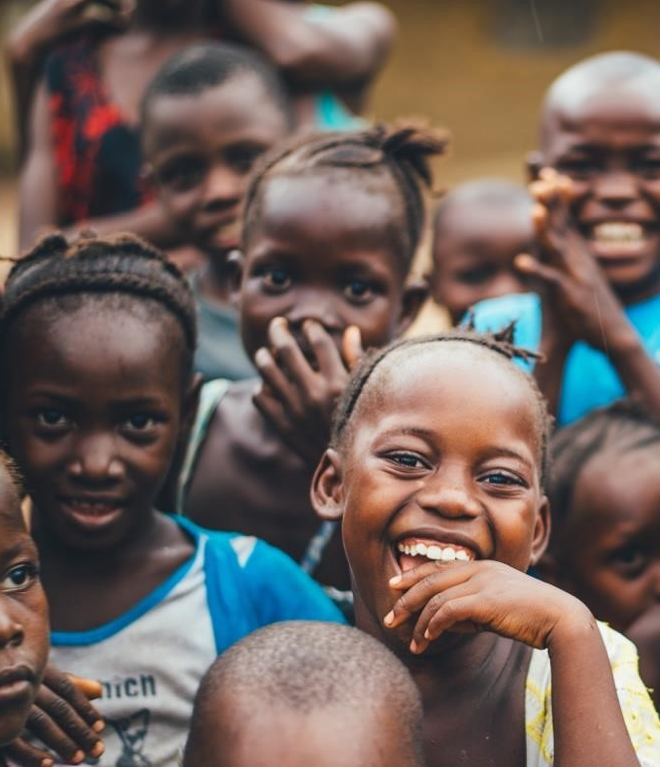
Global Health:
Your can make a difference
The vision of the RCPCH is a ‘healthier’ vision for children and young people across the world’.
As paediatricians, you have a privileged role to play as advocates for the health of the world's children, both in the UK and more globally

Slide 16
Useful Training and Resources
RCPCH ‘Child Health in Low-Income Settings’ Course
Lancet series on Adolescent health, Maternal Health, Early Child Development, Still births, Every Newborn and Equity in Child Survival, Health and Nutrition
Global Health E-learning Centre Free Online Courses on ‘Case Management of Childhood Illness’ and ‘Essential Steps for Improving Newborn Survival’ and ‘Nutrition: An Introduction’
World Health Organisation and UNICEF websites
Article on ‘Medical and Social Needs of Child Refugees in Europe’ available at https://adc.bmj.com/content/101/9/839

Slide 17
Examples from the Curriculum
Level 1
Attends a perinatal meeting and reflects on the importance of the continuum of care and the interdependence of maternal and child health.
Sees a child in the emergency department with fever and finds information on the prevalence and incidence of disease in different countries
Recognises children at risk of TB and refers appropriately.
Reflects on some of the key determinants of child health and wellbeing globally

Slide 18

Examples from the Curriculum
Level 2
Assesses and manages a returning child traveller with fever, taking an appropriate travel and contact history
Evaluates the special health needs of a child recently arrived in the UK from a low-income country
Explores cultural beliefs around health with a child/young person and their family, and recognises how these may impact health behaviours

