Slide 1
Domain 6:
Leadership & team working
Notes:
These slides are designed to help support trainees and/or trainers when delivering teaching related to the leadership and team working domain. Each slide is standalone, and they are not intended to necessarily be used together as a full presentation.

Slide 2
Curriculum overview
Structural changes
  Reduction in the overall indicative length of training from eight to seven years.
Change to two training levels
  Core Level Paediatrics (Year 1-4)
  Specialty Level Paediatrics (year 5-7)
Changes with a view to improving flexibility:
Embedding capability rather than time-based training
Removal of the requirement to do six-month blocks (e.g., neonates, community child health).
Mapping of similarities between sub-specialties so trainees can change pathway and count capabilities already achieved.
Promotion of OOP (out of programme) opportunities.

Slide 3
Core Level –
Curriculum Learning Outcome 6
Leadership and team-working skills are essential throughout training, with a focus on applying these skills across primary and secondary care settings, including social care, to promote the well-being of babies, children, and young people.
Core training develops autonomous leadership, enabling effective participation in multidisciplinary team (MDT) meetings and inter-professional collaboration to optimize care.
Core Learning outcome | Key capabilities
Develops personal leadership skills and demonstrates their own leadership qualities, adjusting their approach, where necessary; utilising these skills to work constructively within multi-disciplinary teams (MDTs), valuing the contributions of others. | Participates effectively and constructively in the multi-disciplinary (MDT) and inter-professional teams, engaging with children, young people and families, facilitating shared decision making. Develops leadership and team-working skills and relevant problem-solving strategies in clinical management contexts, such as where there is limitation of resources. Supports appropriate decisions made within a team and communicates these effectively.

Slide 4
Specialty Level –
Curriculum Learning Outcome 6
The trainee leads a multi-disciplinary team, promoting an open culture of learning and accountability by challenging and influencing the behaviour of colleagues and supporting the development of their leadership qualities and critical decision-making skills.
Specialty Learning outcome | Key capabilities
Leads in multi-disciplinary teams (MDTs) promoting an open culture of learning and accountability by challenging and inspiring colleagues, supporting the development of leadership qualities and critical decision-making skills. | Takes an active role in promoting the optimum use of healthcare resources. Works closely with all professional groups involved in creating a comprehensive care pathway. Addresses challenging behaviour within the team and retains leadership qualities in situations of stress and conflict. Engages effectively with stakeholders such as children, young people, families, charities and other healthcare organisations to create and/or sustain a family centred service. Works with non-clinical and managerial colleagues to promote an effective paediatric service which meets the needs of children, young people and their families. Retains leadership qualities in situations of stress and conflict.

Slide 5
Underpinning knowledge
Leadership & team working
Leadership styles, principles approaches and techniques
What makes a successful team, differing roles within a team
Managing conflict with the team, influencing, challenging.
Supervision, appraisal and mentoring to promote a learning culture.

Slide 6

What is leadership?
“If your actions inspire others to dream more, learn more, do more and become more, you are a leader.” (John Quincy Adams)
Notes:
Pic: https://www.freeimages.com/photo/duck-crossing-1360983

Slide 7
What is leadership?
A manager... | A leader...
Instructs Sets standards for behaviour Implements strategy - 'how we are going to get there' Sets objectives and tasks Ensures processes are followed Has power Is respected due to their position Enforces | Inspires Influences others through their own behaviour Drives strategy - 'where we are going' Spearheads change/process improvement Articulates or demonstrates a vision Has authority Is seen as a role model Generates enthusiasm
Notes:
You don't have to be a consultant or directly line managing people to be a leader. Leadership is a way of being, a set of skills and attributes you can naturally have or work on developing over time.

Slide 8

Leadership & team working in daily practice
Today I have...
Delivered an impromptu bedside teaching session for med students
Defused a heated situation with a patient's parent.
Delivered difficult news sensitively
Participated in an MDT meeting
Given a colleague constructive feedback.
Asked for feedback and advice
Effectively handed over of my patients at the end of my shift.
Notes:
Consider examples of how you naturally show leadership and good team working skills in your normal day-to-day work.
https://pixabay.com/photo-2027619/

Slide 9
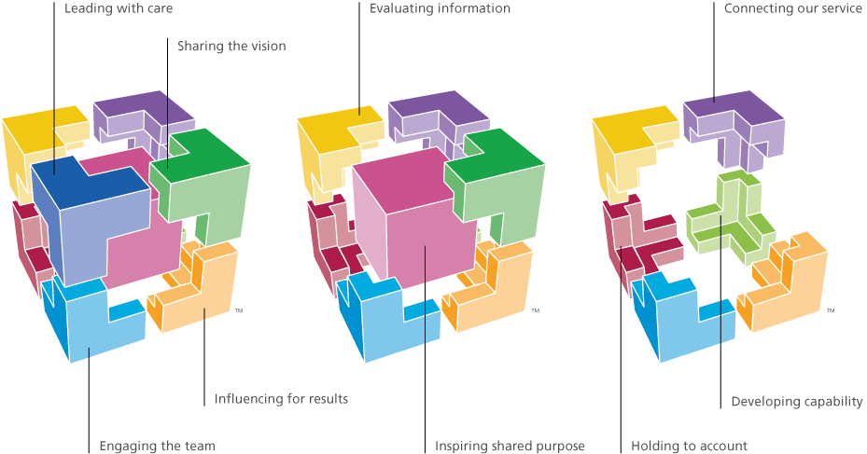
NHS Healthcare Leadership model
https://www.leadershipacademy.nhs.uk/resources/healthcare-leadership-model/

Slide 10
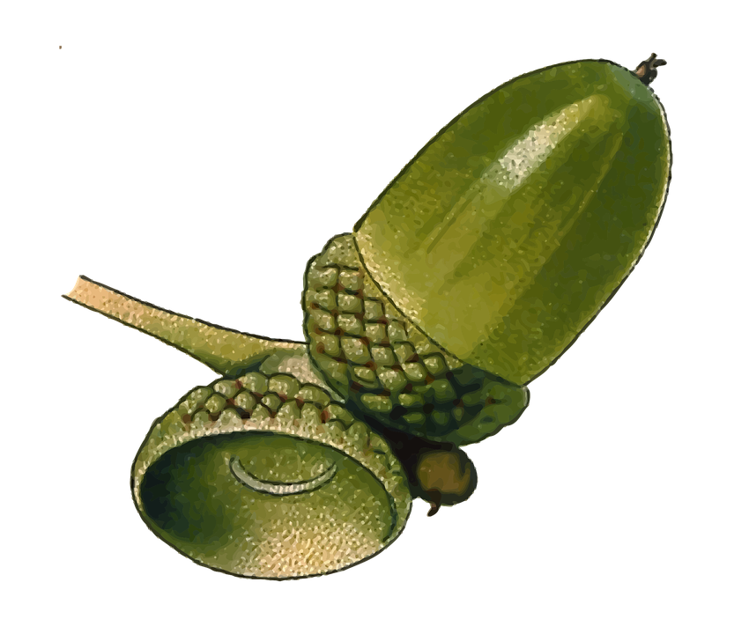

The 'GROW' model
Goal | Reality | Options | Will
What do you want to achieve? | Describe the current situation | What are your options? | What actions will you take?
Confirm the intended goal/outcome. Is it SMART? Will you be motivated to achieve it? | Fully assess the current situation, avoiding or challenging assumptions. What factors influence the existing reality? | Consider all options, identifying any obstacles and how to best tackle these. What would the outcome be of implemeting each option? Decide which to pursue. | Identify the specific tasks/actions needed to make your plan a reality. Who needs to do what, and by when? How will you monitor progress and judge success?
Notes:
A coaching tool – useful for helping others or yourself with problem solving and setting goals.
https://pixabay.com/photo-309878/
https://pixabay.com/photo-1299954/

Slide 11
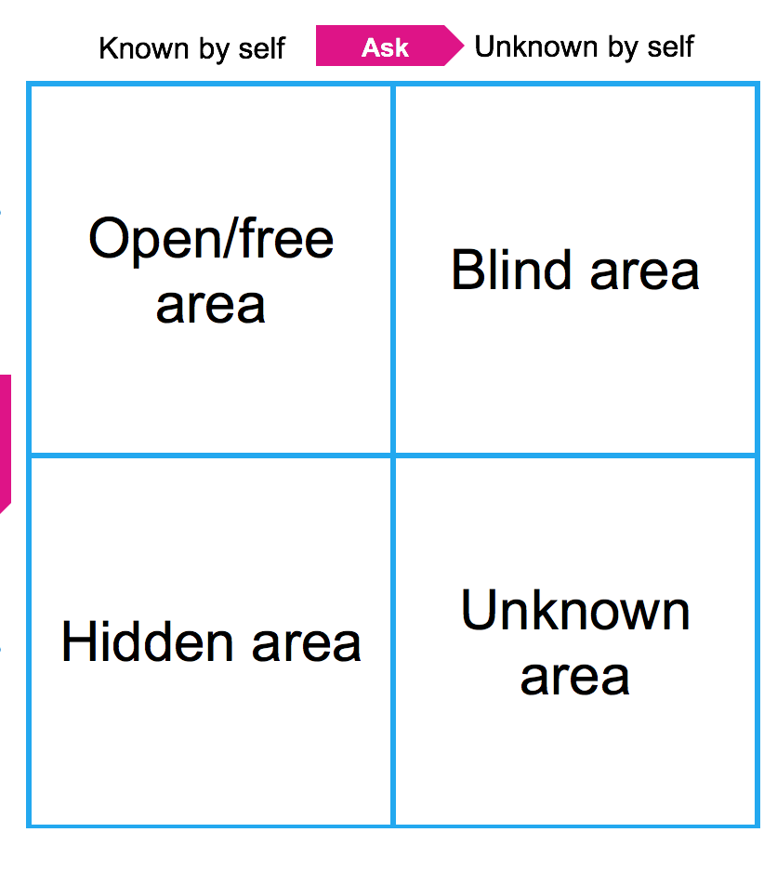
Johari window
Used to support improved:
Self awareness & personal development
Communication
Relationships
Consider:
Which quadrants would be largest for you?
What are your blind areas and how can you decrease them?
Do you share enough (or too much!) with others?
Notes:
More information: https://www.leadershipacademy.nhs.uk/wp-content/uploads/2014/10/NHSLeadership-LeadershipModel-colour.pdf

Slide 12

Understanding different styles
Introvert
Extrovert
Intuative
Sensor
Feeler
Thinker
Perceiver
Judger
Autocratic
Coercive
Notes:
Carl Jung identified different personality traits, categorising people by four different psychological functions and their dominant approach to each. A good team benefits from individuals with a range of these e.g. a mix of introverts and extroverts.
Use MBTI or similar to help consider not only which style best reflects you, but what about others you work with who may be the opposite styles. What may motivate them to react as they do in different circumstances? What value do they add with their differing approach?
See https://www.myersbriggs.org/my-mbti-personality-type/mbti-basics/c-g-jungs-theory.htm?bhcp=1
https://pixabay.com/photo-2025725/

Slide 13
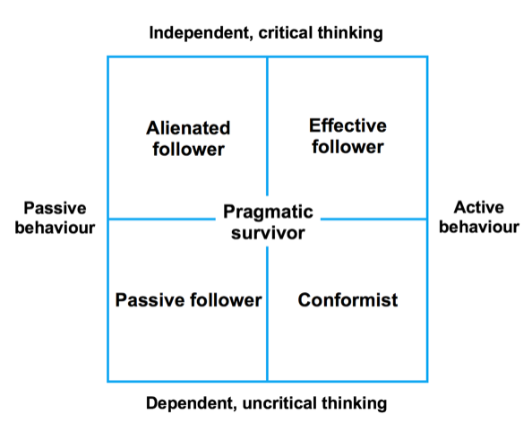
Situational Leadership: different leadership styles are appropriate in different situations
Kelley 1988, Rohde & Ford, 2007; Daft, 2007

Slide 14
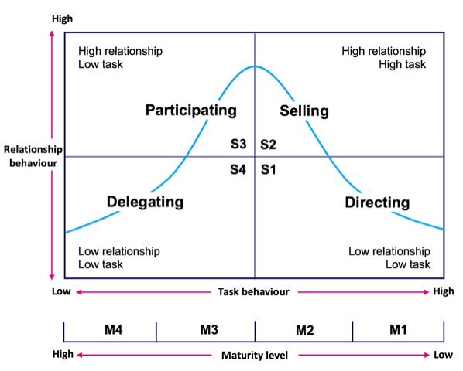
What kind of a team member are you?
Hersey & Blanchard situational leadership model
Notes:
Hersey & Blanchard’s model states that instead of using just one style, leaders should adapt their leadership styles based on the maturity of the people they’re leading and the specifics of the task.
The maturity levels range from an incompetence or unwillingness to perform the task, to a willingness and ability to perform.
For M1 (lacks skills or confidence to work autonomously) use S1- tell or direct
For M2 (willing to work on tasks, lack skills to complete successfully use S2 – sell or coach
For M3 (able and willing to perform tasks but lacks confidence in their ability) use S3 – participating or supporting
For M4 (able to work autonomously, with high confidence and skills) use S4 – delegating

Slide 15


Useful training and resources
Stepping up programme - transition to new consultant
RCPCH Courses: Effective Educational Supervision/ Effective Educational Supervision Plus
RCPCH Course: Mentoring Skills
MSF 360 feedback assessment tool
NHS Leadership Academy (https://www.leadershipacademy.nhs.uk/resources/)
London Leadership Academy toolkit (https://www.londonleadershipacademy.nhs.uk/leadershiptoolkit)
NHS Developing People – Improving Care framework (https://improvement.nhs.uk/resources/developing-people-improving-care/)

