Slide 1
Domain 1:
Professional values, behaviours and knowledge

Slide 2
Curriculum overview
Structural changes
  Reduction in the overall indicative length of training from eight to seven years.
Change to two training levels
  Core Level Paediatrics (Year 1-4)
  Specialty Level Paediatrics (year 5-7)
Changes with a view to improving flexibility:
Embedding capability rather than time-based training
Removal of the requirement to do six-month blocks (e.g., neonates, community child health).
Mapping of similarities between sub-specialties so trainees can change pathway and count capabilities already achieved.
Promotion of OOP (out of programme) opportunities.

Slide 3
Core Level –
Curriculum Learning Outcome 1
This domain sets out the requirements of the trainee in relation to professional values and behaviours. This encapsulates duty of care, legal and ethical frameworks, advocacy, accountability and responsibility.
In addition to the professional values and behaviours required of all doctors (Good Medical Practice), a paediatric trainee must maintain confidentiality, understanding that disclosure may be required in relation to safeguarding.
Core Learning outcome | Key capabilities
In addition to the professional values and behaviours required of all doctors (Good Medical Practice), a paediatric trainee must adhere to legal frameworks relating to babies, children, young people and families/carers, including relevant safeguarding legislation related to the four nations. | Demonstrates the professional values, behaviours and attitudes required of doctors (outlined in Good Medical Practice) within the scope of their knowledge, skills and performance. Demonstrates compassion, empathy and respect for children, young people and their families. Demonstrates self-awareness and insight, recognising their limits of capability and demonstrating commitment to continuing professional development (CPD). Assesses the capacity of children and young people to make informed decisions about their medical care. Follows the principles of the law with regard to consent, the right to refuse treatment, confidentiality and the death of a baby, child or young person.

Slide 4
Specialty Level –
Curriculum Learning Outcome 1
This domain requires the trainee to develop their knowledge of the current legal framework related to babies, children, young people, families and carers to their clinical practice (e.g., adoption and safeguarding).
This is in the context of the skills of self-regulation and applying a self-regulatory approach to their own behaviour and demonstrating the professional qualities required by a paediatrician undertaking independent practice.
Learning outcome | Key capabilities
Acts as a role model by taking a self-regulatory approach in ensuring professional values and behaviours, demonstrating the qualities required by a paediatrician undertaking independent practice. | Demonstrates leadership in the management of relationships where religious or cultural beliefs may cause conflict between children, young people and families and healthcare professionals. Acts as a role model to colleagues by demonstrating a flexible, holistic, reflective, evidence-based approach to practice. Practises independently in a safe manner.

Slide 5
Underpinning knowledge
Professional values & behaviours
Accountability and Responsibilities
Reflection and Resilience
Positive Professional attributes e.g. honesty, integrity, empathy
Legislation, Duty of Candor, GMP, GPCs
H&S and E&D.

Slide 6


Useful training and resources
Local training on Duty of Candour
Child Bereavement Days
Level 3 Safeguarding Training
RCPCH Safeguarding courses and e-learning (https://www.rcpch.ac.uk/resources/safeguarding-available-learning-resources)
RCPCH courses: Effective Educational Supervision / EES plus
RCPCH course: Mentoring skills
Notes:
Add in any local training or resources

Slide 7
Professionalism case studies
A trainee organised the local paediatric training programme around case presentations. Of the four cases presented monthly, one is always presented by the patient or parent themselves.
A 14-year-old patient presents with cardiac arrest after a suspected overdose. CPR is attempted but is unsuccessful. The trainee carries out examination of the body, supervised by the consultant, with the police.
Follow-up with a 13-month baby born at 31 weeks indicates a genetic disorder which may have been hereditary. The trainee discusses the possible impact on developmental milestones with the parents, and the pros and cons of further testing for the family, who are hoping to have another child.
SUDI in a 2-month-old, Muslim family. The family are keen to bury the baby within 24 hours as per their religious beliefs. The trainee discusses with the coroner, then gets the Iman to speak with the family to explain why this is not going to be possible.
9-month-old with unexplained skull fracture. Parents are local GPs. Full safeguarding workup is needed – the trainee is non-judgmental, liaises with relevant agencies and discusses with the consultant early, but does so with tact and diplomacy given who the parents are.
Additional case studies can be found on the website.
Notes:
Consider how these examples relate to the professional values, behaviours and knowledge Learning Outcomes. Compare to the illustrations in the syllabus for prompts. E.g. involving patients in presenting cases – ‘Identifies opportunities and shows commitment for child health advocacy in their daily practice, including examples of injustice, empathy and political influences. (level 1)’
Discuss which assessment tool would be the most appropriate in each case.

Slide 8
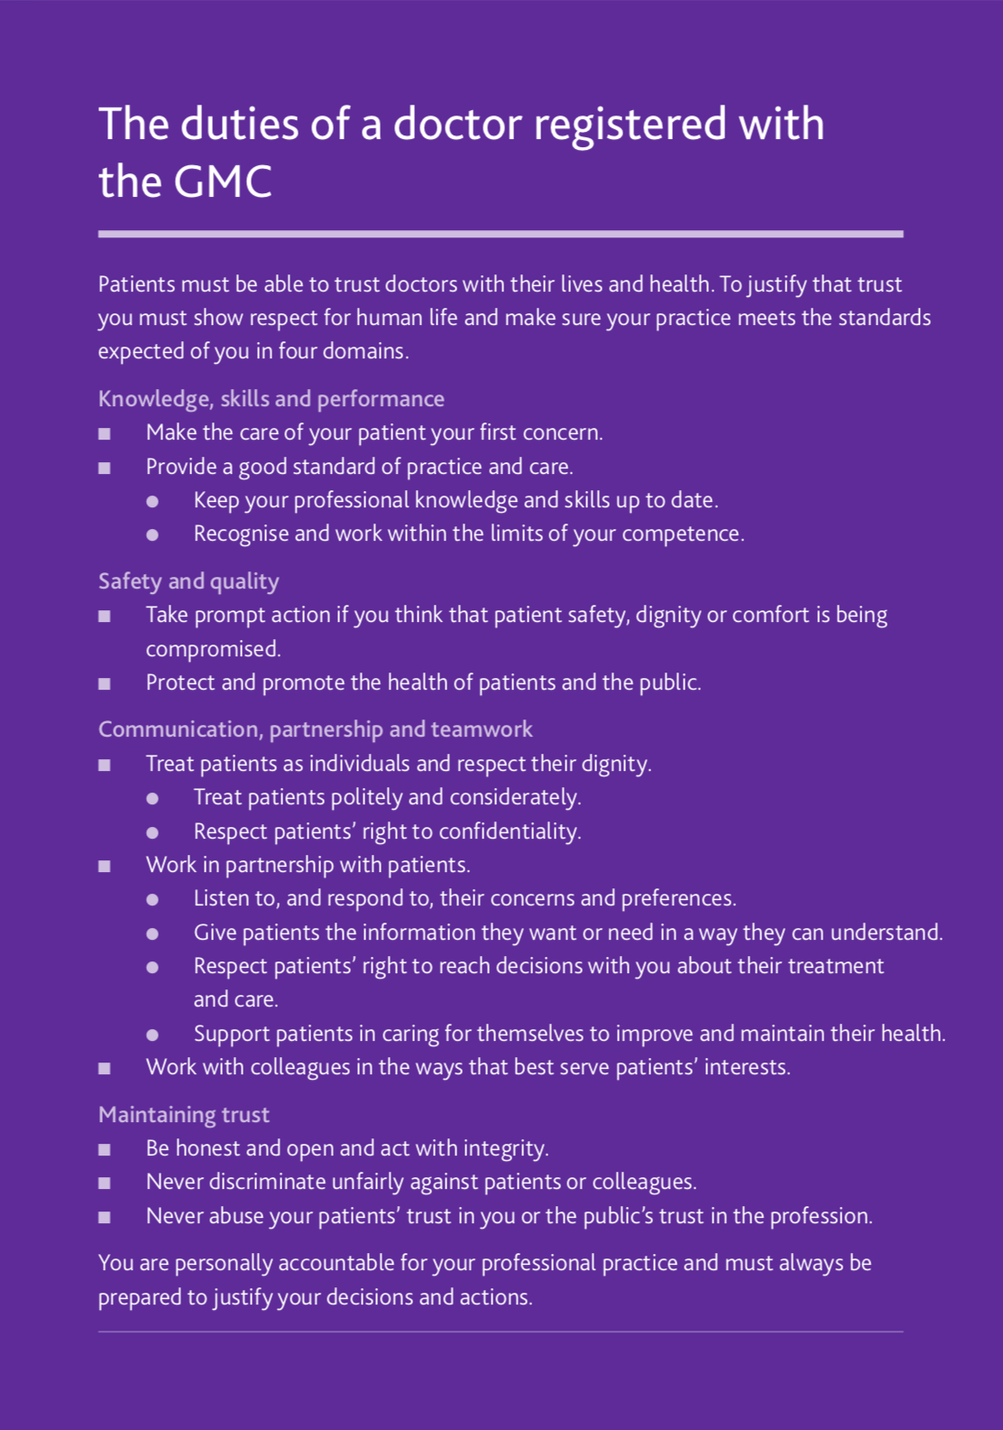

Good Medical Practice (GMP)
https://www.gmc-uk.org/ethical-guidance/ethical-guidance-for-doctors/good-medical-practice

Slide 9
Good Medical Practice (GMP)
1. Knowledge, skills & performance
  Apply knowledge and experience to practice
  Record your work clearly, accurately and legibly
  Contribute to and comply with systems to protect patients
2. Safety and quality
  Respond to risks to safety
  Protects patients and colleagues from any risk posed by your health
  Communicate effectively
Professionalism in action
4. Maintaining trust
  Treat patients and colleagues fairly and without discrimination
  Act with honesty and integrity
3. Communication, partnership & teamwork
  Work collaboratively with colleagues to maintain or improve patient care
  Teaching, training, supporting and assessing
  Continuity and coordination of care
  Establish and maintain partnerships with patients.

Slide 10

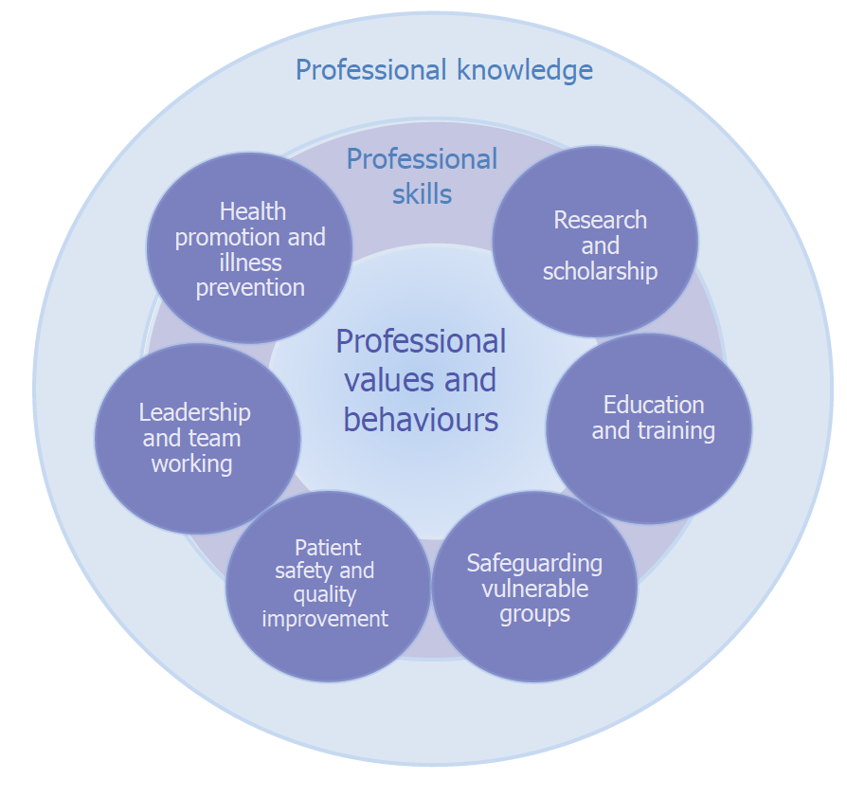
Generic Professional
Capabilities (GPC)
https://www.gmc-uk.org/-/media/documents/generic-professional-capabilities-framework--0817_pdf-70417127.pdf

Slide 11
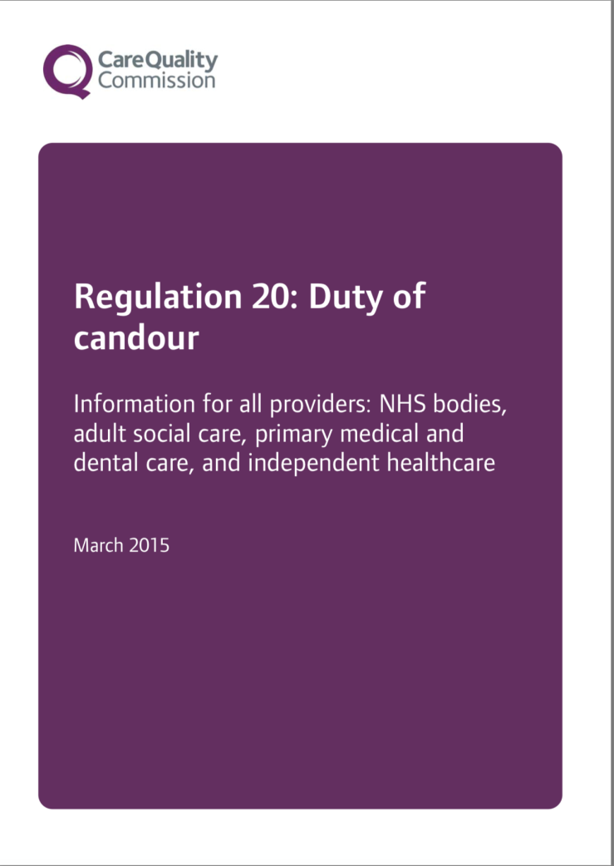
Professional duty of candour
CQC Regulation 20 requires:
Openness – enabling concerns and complaints to be raised freely without fear and questions asked to be answered.
Transparency – allowing information about the truth about performance and outcomes to be shared with staff, patients, the public and regulators.
Candour – any patient harmed by the provision of a healthcare service is informed of the fact and an appropriate remedy offered, regardless of whether a complaint has been made or a question asked about it.
https://www.cqc.org.uk/guidance-providers/regulations-enforcement/regulation-20-duty-candour

Slide 12
Candour in action
Act in an open and transparent way with relevant persons in relation to care and treatment provided to people who use services in carrying on a regulated activity.
Tell the relevant person, in person, as soon as reasonably practicable after becoming aware that a notifiable safety incident has occurred and provide support to them in relation to the incident, including when giving the notification.
Provide an account of the incident which, to the best of the provider’s knowledge, is true of all the facts the body knows about the incident as at the date of the notification.
Advise the relevant person what further enquiries the provider believes are appropriate.
Offer an apology.
Follow up the apology by giving the same information in writing and providing an update on the enquiries.
Keep a written record of all communication with the relevant person.

Slide 13
Notifiable safety incidents
The death of the service user, where the death relates directly to the incident rather than to the natural course of the service user’s illness or underlying condition.
An impairment of the sensory, motor or intellectual functions of the service user which has lasted, or is likely to last, for a continuous period of at least 28 days.
Changes to the structure of the service user’s body.
The service user experiencing prolonged pain or prolonged psychological harm.
The shortening of the life expectancy of the service user.
Or requirement for additional treatment to prevent one of the harms described above.

