Slide 1
Domain 7 & 8:
Patient Safety & Quality improvement, including Safe Prescribing
Presentation drawn together by:
Dr Fiona Hignett – Paediatric Registrar, Wessex.
With thanks to:
Kate Pryde (consultant paediatrician, Southampton Children’s Hospital)
Matt Smith (consultant anaesthetist Derriford Hospital, Plymouth)
Notes:
Presentation drawn together by Dr Fiona Hignett – Paediatric Registrar, Wessex.
With thanks to Matt Smith (consultant anaesthetist Derriford Hospital, Plymouth); Kate Pryde (consultant paediatrician, Southampton Children’s Hospital)

Slide 2
Curriculum overview
Structural changes
  Reduction in the overall indicative length of training from eight to seven years.
Change to two training levels
  Core Level Paediatrics (Year 1-4)
  Specialty Level Paediatrics (year 5-7)
Changes with a view to improving flexibility:
Embedding capability rather than time-based training
Removal of the requirement to do six-month blocks (e.g., neonates, community child health).
Mapping of similarities between sub-specialties so trainees can change pathway and count capabilities already achieved.
Promotion of OOP (out of programme) opportunities.

Slide 3
Core Curriculum Learning outcome 7 –
Patient Safety including Safe Prescribing
Doctors at every stage in their career must demonstrate that they can prioritise, promote and encourage patient safety. Trainees must understand the importance of safe prescribing and show that they can prescribe medications in a safe manner.
The trainee must identify risk autonomously and promote patient safety at all times.
Core Learning outcome | Key capabilities
Recognises the importance of patient safety, including safe prescribing and exposure to risk/hazard. | Understands the relationship between hazards, risks of exposure and likelihood of harm. Recognises when a baby, child or young person has been exposed to a risk/hazard and escalates in accordance with local and national procedures. Applies safety procedures to prescribing practice, demonstrating an understanding of pharmacogenomics, following local and national processes in instances of patient harm or medication error. Applies safety procedures when ordering blood, with adherence to local and national policies. Applies safety and reporting procedures to clinical care situations, responding to identified risks/hazards. Applies the Duty of Candour principles to practice. Recognises when the behaviours of a child or young person puts themselves or others at risk of harm.

Slide 4
Core capabilities in Quality Improvement
Doctors in all stages of their career must promote and encourage all aspects of quality improvement, striving for improved experiences and patient outcomes. Improving the quality of care and service provision is a key aspect of all doctors’ duties.
Core training will allow trainees to increase their confidence in using quality improvement tools and participating in improvement projects.

Slide 5
Specialty Curriculum Learning outcome 7 –
Patient Safety including Safe Prescribing
Trainees will consider all aspects of patient safety and prescribing practice. This will occur unsupervised, and the trainees will be role modelling to junior staff.
Specialty Learning outcome | Key capabilities
Takes responsibility for investigating, reporting, resolving and evaluating risk/hazard incidents within different paediatric healthcare settings, including communication with affected children or young people and their families/carers. | Advises children, young people and their families about the importance of concordance and about the actions of medications, including their side effects. Takes account of risks to themselves and others within the clinical environment, including those related to personal interactions and biohazards. Participates in investigating, reporting and resolving serious incidents, including through communication with children, young people and their families.

Slide 6
Specialty capabilities in Quality Improvement
The trainee will demonstrate skill in optimising opportunities for improvement. This includes improvement across a range of areas, such as patient care, service delivery and management.
The trainee is now an automatous reflective practitioner.

Slide 7
Underpinning knowledge
Patient safety & safe prescribing
Patient safety priorities and risk management
Learning from errors
Knowledge of formularies and guidelines
The ethics of prescribing

Slide 8
Core Curriculum Learning outcome 8 –
Quality Improvement (QI) process
Core Learning outcome | Key capabilities
Applies quality improvement (QI) methodology to clinical practice, thereby learning and reflecting to foster positive change. | Proactively identifies opportunities for quality improvement. Undertakes projects and audits to improve clinical effectiveness, patient safety and patient experience. Participates in local clinical governance processes.

Slide 9
Specialty Curriculum Learning outcome 8 –
Quality Improvement (QI) process
Specialty Learning outcome | Key capabilities
Independently applies knowledge of quality improvement (QI) processes by initiating, planning and undertaking projects and audits to improve clinical effectiveness, patient safety and patient experience. | Responds appropriately to health service targets and participates in the development of clinical services. Employs the principle of evaluation, audit, research and development to improve healthcare, including children and young people’s experiences. Applies understanding of national and local regulatory bodies, particularly those involved in standards of professional behaviour, clinical practice and education, training and assessment.

Slide 10
Underpinning knowledge
Quality improvement
Quality improvement models and theories e.g. PDCA
Collecting and managing stakeholder feedback
Differences between quality assurance. management, control and improvement
Evaluation and measuring impact

Slide 11


Patient Safety & Quality Improvement
Patient Safety
“Patient safety is the avoidance of unintended or unexpected harm to people during the provision of health care”
(The WHO & NHS Improvement)
Quality Improvement
"The combined and unceasing efforts of everyone to make the changes that will lead to better patient outcomes (health), better system performance (care) and better professional development (learning)“
(Batalden and Davidoff, 2007)
Notes:
There is no single definition of ‘quality improvement’ nor patient safety, and no approaches appear to be more successful than others.
Some examples of definitions are included here
What is clear is that to consider patient safety and quality improvement as 2 separate entities would be a misunderstanding of their concepts entirely – as they are intrinsically linked
Hence presenting both domain 7 (patient safety including safe prescribing) and domain 8 (quality improvement) in this presentation.
So what is quality care and why is it important?

Slide 12
What is Quality Care?
QUALITY
SAFE
EFFECTIVE
PATIENT CENTERED
TIMELY
EFFICIENT
EQUITABLE
TEAM VALUES, EDUCATION TRAINING & LEARNING, ENVIRONMENT
(Crossing the Quality Chasm IOM, 2001)
Notes:
Six aims for Improvement - Institute of Medicine (IOM)
The Institute of Medicine in the United States has identified six aims for improvements to achieve the ideal healthcare system.
These aims are often used within quality improvement literature. They are all linked but the challenge for the NHS is to balance them.
“In order to begin achieving real improvement in health care, the whole system has to change”
Good healthcare should be:
Safe - Be as safe for patients in health care facilities as in their home
Effective - Match science, with neither underuse nor overuse of the best available techniques
Patient Centered - Revolve around the patient who should play an active role in making decisions about their own care
Timely - Mean that patients do not experience waits or delays in receiving care and services
Efficient - Be cost effective and reduce/remove waste
Equitable - Disparities in care should be eradicated
Crossing the Quality Chasm (IOM 2001)

Slide 13
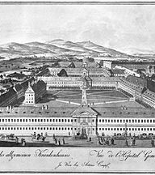
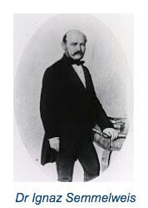
Safety & Improvement
Through the Ages…
Notes:
Understanding patient safety and implementing improvement methodologies are by no means a ‘modern’ discovery – lesson learnt in the past of our medical history can teach us a lot today…
In the 19th Century puerperal fever was one of those diseases that intrigued and baffled doctors – it was a true patient safety catastrophe with mortality rates in excess of 15%...
By reviewing and collecting data, Dr Ignaz Semmelwies, a Hungarian physician, recognised that there was a difference in mortality rates in his midwife led unit (lower rates of infection) than his physician led unit (higher rates of infection).

Slide 14
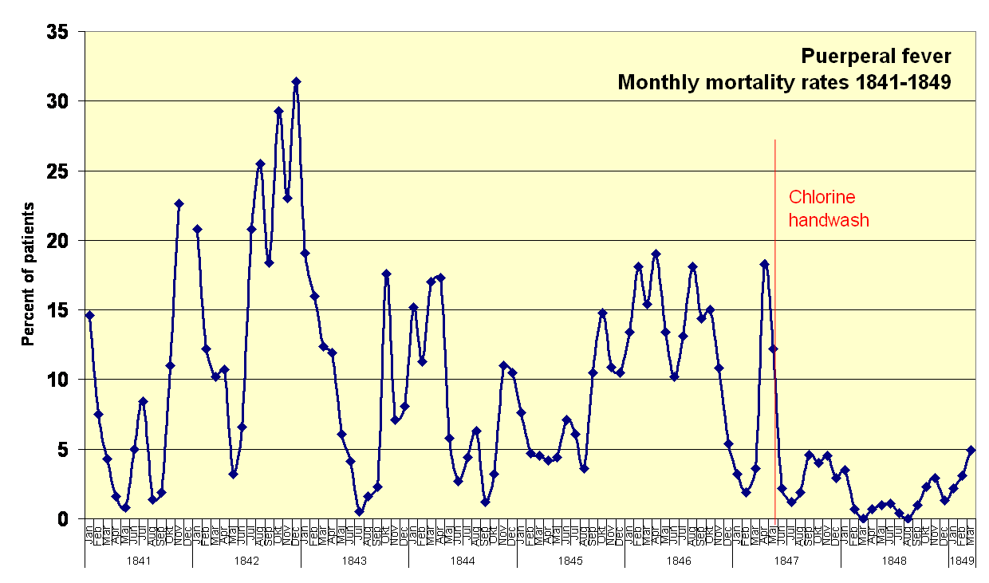
Notes:
Despite successfully reducing puerperal fever mortality by the introduction of chlorine handwash, the medical community could not understand nor believe his hypothesis
Semmelweis was dismissed from the hospital and harassed by his peers – so passionate and deep seated was his belief he wrote open letters to the medical community accusing them of being irresponsible murderers leading to his family and contemporaries believing he was losing his mind and having him committed to an asylum where he sadly died soon after
His practice only became truly accepted when louis Pasteur developed the germ theory of disease and offering a theoretical explanation
So what does this teach us??
Making changes to improve safety and quality of care isn’t always easy
You need to have all ‘stakeholders on board’
Data drives improvement
Don’t give up!

Slide 15


Slide 16
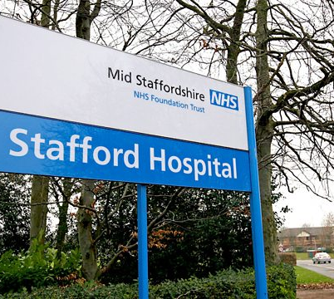

We’re still learning…
Notes:
Unfortunately within the NHS we still do not always get things right and we’re still learning.
Endemic & systemic failures found at mid Staffs hospital trust in the early 2000’s were thoroughly investigated and brought to light by the Francis Inquiry Report.
This report made 290 recommendations for improving the safety and quality of care of patients in the entire NHS, although a lengthy read, having an understanding of the failings found and recommendations is important.
https://www.gov.uk/government/collections/mid-staffordshire-nhs-foundation-trust-news-and-publications

Slide 17
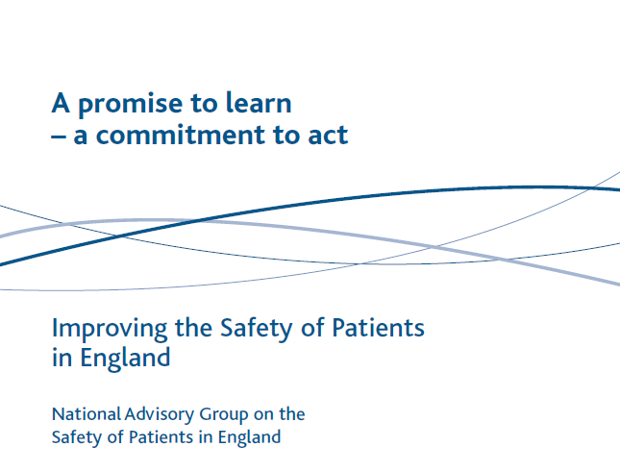

A Promise to Learn,
A Commitment to Act
Notes:
Following the Francis report, Don Berwick (former Chief Executive Officer for the Institute for Healthcare Improvement or IHI), was asked by the British Prime Minister to carry out a review of the NHS as a whole
He spent years understanding the NHS ‘system’ and all the components that come together to make it what it is, including patients staff and infrastructure.
His report entitled ‘A Promise to Learn, A Commitment to Act’ summarises these findings and provides us with 4 key recommendations
Place the quality and safety of patient care above all other aims for the NHS. (This, by the way, is your safest and best route to lower cost.)
Engage, empower, and hear patients and carers throughout the entire system, and at all times.
Foster wholeheartedly the growth and development of all staff, especially with regard to their ability and opportunity to improve the processes within which they work.
Insist upon, and model in your own work, thorough and unequivocal transparency, in the service of accountability, trust, and the growth of knowledge.
https://youtu.be/xb-PjOgxHeo
https://www.gov.uk/government/publications/berwick-review-into-patient-safety

Slide 18
So how do we know if we’re providing a ‘quality’ service?
Patient/parent feedback
Patient Outcomes
Staff survey
Complaints
CQC Report
Audit
Favourable Events ‘LfE’
Adverse Events
Targets
Notes:
Taking on board the 4 recommendations from Berwick for ensuring a safer healthcare system, how do we know if we’re providing a ‘quality’ and safe service?
The ways we can determine this are numerous – from more reactive measures such as CQC reports and complaints, to proactive measures such as favourable events or ‘learning from excellence’

Slide 19

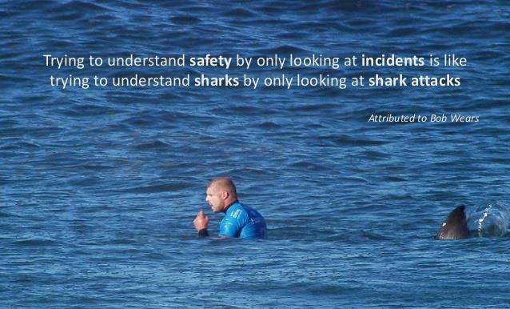
Turning Safety & Quality on It’s Head…
Safety I vs Safety II
  Eric Hollnagel, EUROCONTROL, 2015
Notes:
When we think of safety it is usually by reference to its opposite, the absence of safety.
The traditional view of safety, called Safety-I, has consequently been defined by the absence of accidents and incidents, or as the ‘freedom from unacceptable risk.’ As a result, the focus of safety research and safety management is on unsafe system operation rather than on safe operation.
In contrast to the traditional view, resilience engineering maintains that ‘things go wrong’ and ‘things go right’ for the same basic reasons.
This corresponds to a view of safety, called Safety-II, which defines safety as the ability to succeed under varying conditions.
Safety II isn’t just about the great things- it’s also about understanding well functioning normality and doesn’t mean that we ignore safety I altogether!

Slide 20

Notes:
The LfE philosophy: Excellence in healthcare is highly prevalent, but there is no formal system to capture it. We tend to regard excellence as something to gratefully accept, rather than something to study and understand. Our preoccupation with avoiding error and harm in healthcare has resulted in the rise of rules and rigidity, which in turn has cultivated a culture of fear and stifled innovation. It is time to redress the balance. We believe that studying excellence in healthcare can create new opportunities for learning and improving resilience and staff morale.
There are simple ways of doing this – start by saying thank you, write a note or an email, start a formal learning form excellence, ‘Greatix’ or Favourable event reporting system..

Slide 21
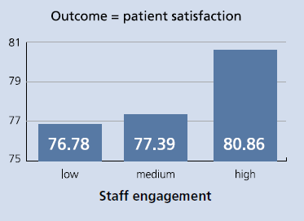
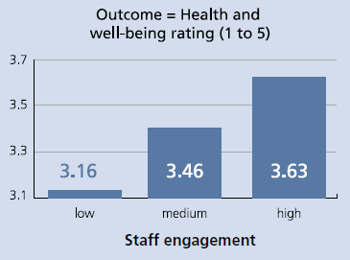
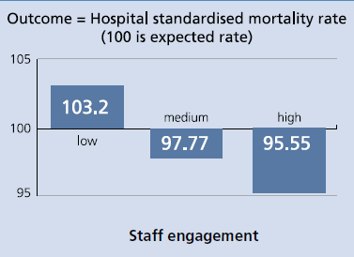

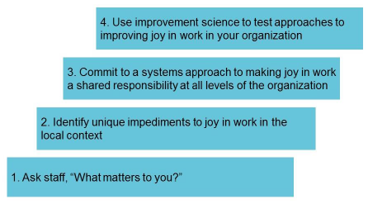
☺ Culture & Joy ☺
Notes:
The Staff Engagement toolkit produced by NHS Employers in 2013 found evidence that highly engaged and empowered staff not only generate better outcomes for patients but also result in improved quality of services, reduced patient mortality, improved staff health and well-being, lower levels of sickness absence and greater financial efficiencies.
Increased staff engagement has been shown to improve the effectiveness of the NHS significantly and it serves as a useful case study for the positive impact increased engagement can have in the public sector.
But healthcare, internationally, is going through a crisis and epidemic of stress, burnout and fatigue
As Don Berwick said we should put quality & safety of patient care above all other aims but we must also foster the growth and development of all staff
The IHI has a suggested simple 4 step tool for fostering and improving joy in work and their white paper outlines how this can be achieved at departmental & institutional levels.
https://qi.elft.nhs.uk/wp-content/uploads/2017/07/IHI-Framework-for-Improving-Joy-In-Work.pdf

Slide 22
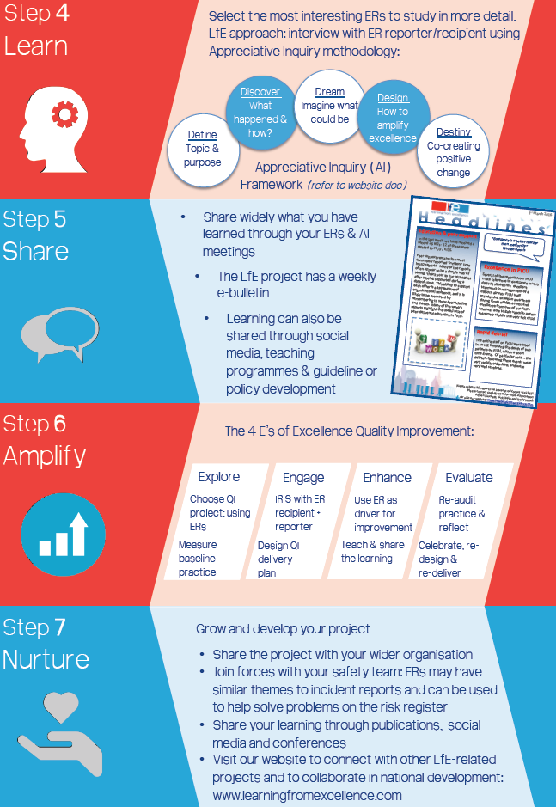
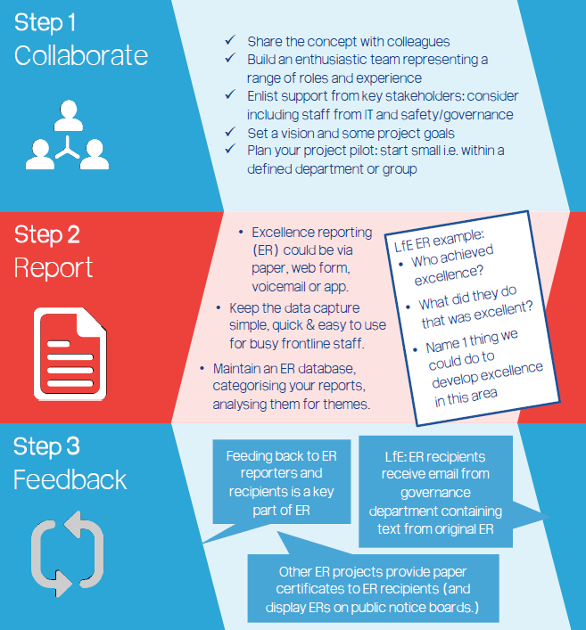
When Something Goes Well… #LfE
Notes:
LfE toolkit: https://learningfromexcellence.com/resources-and-evidence/

Slide 23


When Something Goes Less Well…
Notes:
Be honest, apologize and exercise your ‘duty of candour’
Remember the duty of care we have to all our patients
https://www.gmc-uk.org/ethical-guidance/ethical-guidance-for-doctors/good-medical-practice/duties-of-a-doctor
Report the event
Understand how and why it happened
Take a human factors approach and look at the system as a whole, trying to find one ‘root cause’ is unhelpful
Feedback learning sensitively and constructively
Blame culture will not and does not help…!
For more serious events, SIRI/SUI mechanisms exist within hospitals – risk managers and senior colleagues will be able to explain the local protocols & policies that feed into national policies
Advice as to how to undertake these can be found on NHS improvement & specific training can be undertaken
https://improvement.nhs.uk/resources/serious-incident-framework/

Slide 24

Notes:
Think about how your actions and behaviours reflect on those you work with and care for … what type of shadow do you cast?
Continually strive to improve your own practice & performance and that of the system you work in…
Improvement should be everybody’s business!

Slide 25
Types of Improvement
Research | Audit | Quality Improvement
To generate new knowledge | Judgement against set standards for ‘assurance’ | Broad aims: Improvement in any area of any organisation
Scientific methods used | Formalised methodologies and best-practices for data collection | Methods range from highly pragmatic to in-depth statistical analysis to research
Mainly clinical areas but can also be non-clinical | Can be based on any processes where there are clear standards | Any area of an organisation
Process of approval for funding and ethics approval | Often a planned annual programme or mandated audits for quality assurance | Usually identified from a service need
REACTIVE
PROACTIVE
Notes:
There are many ways we can improve the systems we work in
Research, audit and quality improvement are all tools to help us do this

Slide 26

QI builds bridges between…
Scientific Approaches, theory & knowledge
Delivery of real-life medical care
Above all it is about making the changes that improve practice (for patients and staff)
Notes:
Although all slightly different they have the same goal which is to improve the quality and safety of care we deliver to patients and the culture that we as staff work in

Slide 27
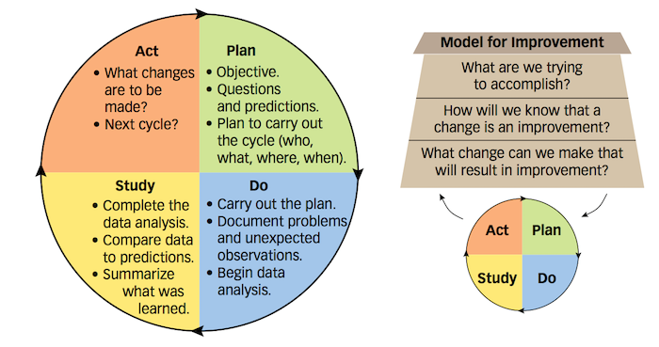
IHI Model for Improvement
http://www.ihi.org/resources/Pages/HowtoImprove/default.aspx
Notes:
The IHI model for improvement is a simple tool which can help to drive improvement
The next few slides will break it down to help you understand the process…
The health foundation ahs a helpful summary of other approaches:
https://www.health.org.uk/sites/default/files/QualityImprovementMadeSimple.pdf

Slide 28
Making Improvements
(1) Understand & Investigate the Situation
Identify a situation
Think 6 domains!
Use tools eg Process map beginning to end
‘Diagnose’ the situation
Notes:
Identify a problem or a situation
Focus on truly understanding a situation – use tools & processes to do this
Demonstrate the understanding with data so you know when change is an improvement

Slide 29
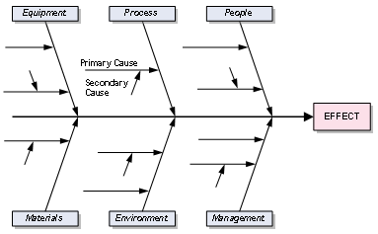
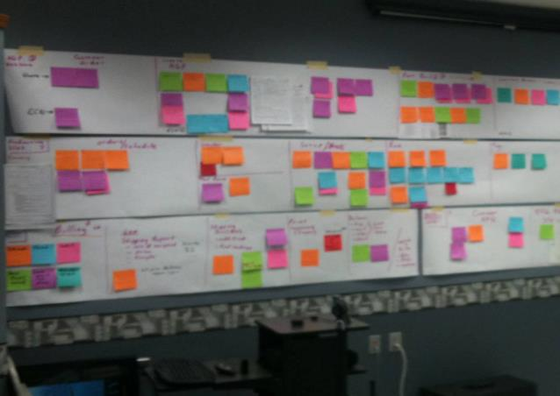
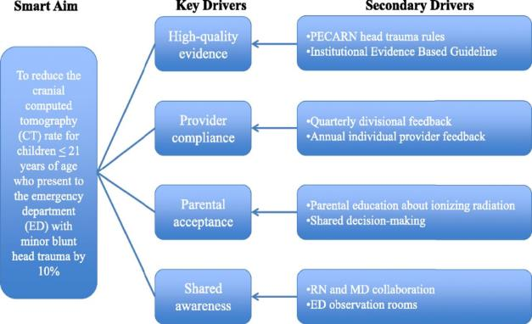
Tools to help
Affinity/Fishbone Diagram
Process Mapping
Driver Diagram
Notes:
Several websites have information about tools to help you understand your situation or problem better..
https://qi.elft.nhs.uk/resources/
http://www.ihi.org/resources/Pages/Tools/Quality-Improvement-Essentials-Toolkit.aspx

Slide 30


Making Improvements
(2) Engage hearts & Minds
Identify A Situation
Think 6 aims!
‘Diagnose’ the situation
Process map beginning to end
Engage with Staff, Patients & Families
Stakeholders
Personal perspective
Notes:
Meet with staff
Meet with patients
Meet with relatives
Have a conversation & Be ‘curious’
Get them on board...!

Slide 31

Making Improvements
(3) Data Drives Improvement
Identify A Situation
Think 6 domains!
‘Diagnose’ the situation
Process map beginning to end & use other tools
Collect Data
Keep it simple
Run charts are fab!
Engage with Staff & Families
Stakeholders
Personal perspective
Qualitative vs quantitative
Notes:
Collect data – data drives improvement!

Slide 32
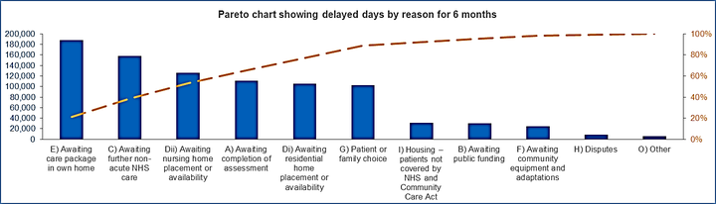
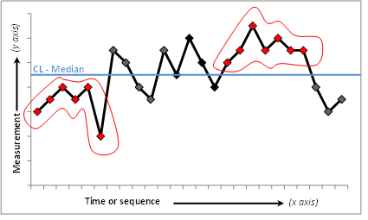
Pareto Chart & Run Charts
Notes:
Pareto Charts
Bars show the total number in each category and are ordered from highest to lowest. An overlaid line shows the cumulative percentage of the total.
Pareto charts can be used to identify and then focus improvement work on the most significant categories. For example, you could use a pareto chart to identify the highest ranked reason for delayed transfers of care reason and what percentage of the total this reason represents. The chart below shows that ‘e) awaiting care package in own home is the highest ranked reason. The orange dashed line shows that this reason accounts for 21% of total delayed days for the period selected.
https://improvement.nhs.uk/resources/pareto-chart-tool/
Run Chart
Graphs which display time-series data are helpful tools for being able to understand and communicate variation in a process.
Plotting the median
6 consecutive plots above tor below he median shows statistical change
https://improvement.nhs.uk/resources/run-charts/
Idea with both is to continually collect & display data to show progress and improvement and share with colleagues in a format that is engaging and easy to interpret

Slide 33
Making Improvements
(4) Making a Change
Identify A Situation
Think 6 domains!
‘Diagnose’ the situation
Process map beginning to end & use other tools
Make a change!
Engage with Staff & Families
Keep it simple
Run charts are fab!
Keep it SMART...
Stakeholders
Personal perspective
Collect Data
Qualitative vs quantitative

Slide 34

A SMART Change
Specific
Measurable
Achievable
Realistic
Timely
Notes:
Make a change but keep it SMART….

Slide 35
Making Improvements
Identify A Problem
Think 6 domains!
Process map beginning to end & use other tools
Make a change!
Engage with Staff & Families
Keep it simple
Run charts are fab!
Keep it SMART...
Stakeholders
Personal perspective
Collect Data
‘Diagnose’ the problem
Qualitative vs quantitative

Slide 36

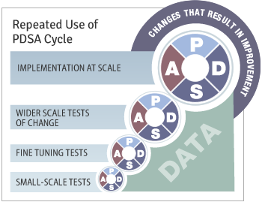
Notes:
Keep the momentum rolling…
Join together changes with repeated PDSA cycles
Remembering to keep each change SMART!
Communicate with your colleagues
Share success, fail fast learn quick!

Slide 37
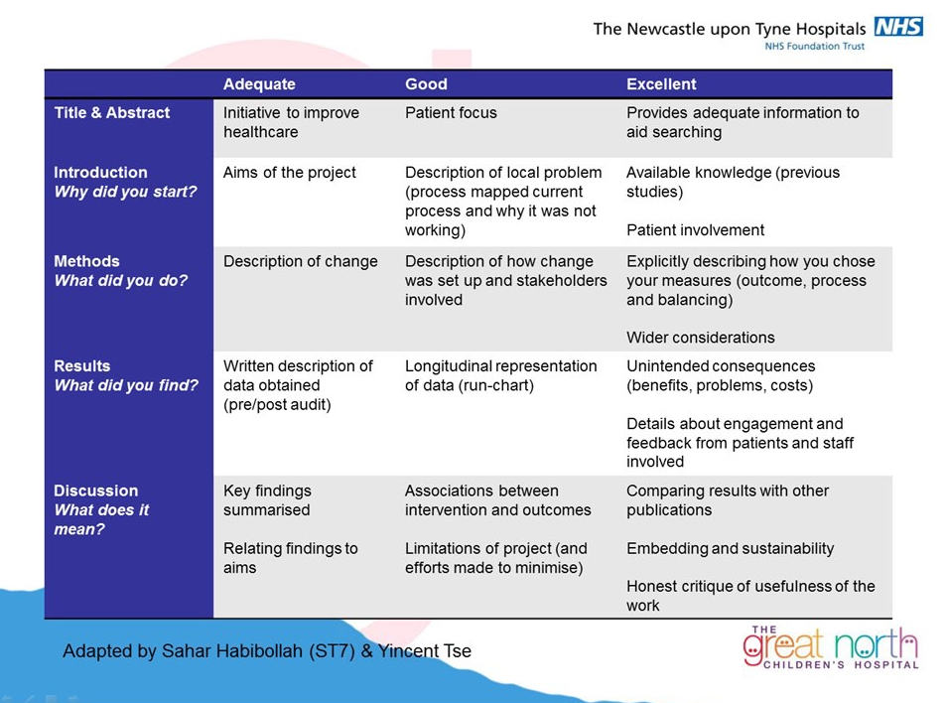
Striving For Success..
Notes:
A summary on how to do the most successful QI project…

Slide 38
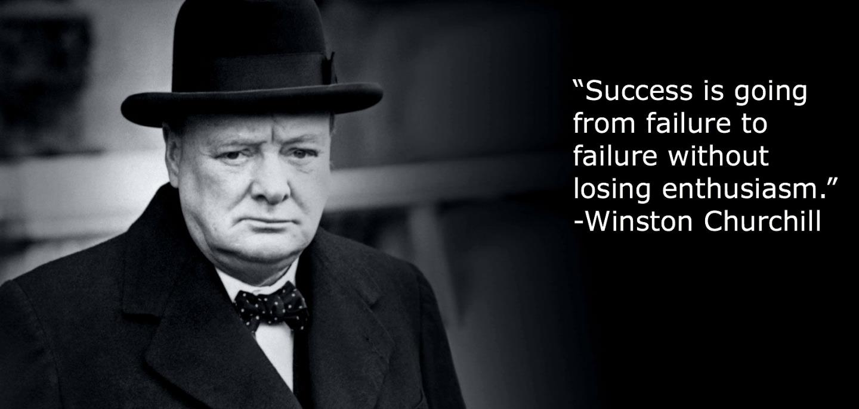

Slide 39
Resources & Reading
Mid-Staffordshire Francis Inquiry Report:
  https://www.gov.uk/government/collections/mid-staffordshire-nhs-foundation-trust-news-and-publications
Berwick Report: A Promise to learn, A commitment to act:
  https://youtu.be/xb-PjOgxHeo
  https://www.gov.uk/government/publications/berwick-review-into-patient-safety
From Safety-I to Safety-II: A White Paper:
  https://www.england.nhs.uk/signuptosafety/wp-content/uploads/sites/16/2015/10/safety-1-safety-2-whte-papr.pdf
RCPCH Compass E-Learning: https://rcpch.learningpool.com
  Quality Improvement
  Paediatric Prescribing Principles
RCPCH QI resources:
  https://www.rcpch.ac.uk/work-we-do/quality-improvement-patient-safety
Paediatric ePrescribing (SCRIPT)
  www.safeprescriber.org

Slide 40
Resources & Reading
Staff engagement toolkit:
  https://www.nhsemployers.org/~/media/Employers/Documents/SiteCollectionDocuments/staff-engagement-toolkit.pdf
IHI Joy in work:
  https://qi.elft.nhs.uk/wp-content/uploads/2017/07/IHI-Framework-for-Improving-Joy-In-Work.pdf
Learning from Excellence:
  https://learningfromexcellence.com/resources-and-evidence/
Duties of a Doctor
  https://www.gmc-uk.org/ethical-guidance/ethical-guidance-for-doctors/good-medical-practice/duties-of-a-doctor
Serious Incident Framework:
  https://improvement.nhs.uk/resources/serious-incident-framework/
IHI Model for improvement:
  http://www.ihi.org/resources/Pages/HowtoImprove/default.aspx
The Health Foundation:
  https://www.health.org.uk/
NHS Improvement:
  https://improvement.nhs.uk/

Slide 41




Useful Conferences/Meetings
http://www.ihi.org/education/Conferences/Pages/default.aspx
  Next meeting March 27–29th, 2019
  Glasgow, Scotland
  BMJ and IHI, with strategic partners, will bring together more than ​3,000 health care leaders and practitioners from 70+ countries
  And if travelling not possible they also have virtual training modules: http://www.ihi.org/education/WebTraining/Pages/default.aspx
https://www.risky-business.com/london.php]
  Yearly conference with Paediatrics Day
  June 5th-7th, London, England
https://www.fmlm.ac.uk/
  Regular meetings with opportunities for trainees to showcase their
  quality improvement work
https://www.rcpch.ac.uk/news-events/rcpch-conference/programme-at-a-glance
  Quality Improvement Committee Specialist Interest Group Sessions to attend
  May 13th-15th May, Birmingham, England

