Slide 1




RCPCH &Us
Address
Email
Website
Podcasts
5-11 Theobald's Road, London WC1X 8SH
and_us@rcpch.ac.uk
www.rcpch.us
rcpchandus.libsyn.com/
#VOICEMATTERS | #CHILDHEALTHMATTERS
Royal College of Paediatrics and Child Health.
Incorporated by Royal Charter and registered as a Charity in England and Wales: 1057744 and in Scotland: SCO38299.
Registered Office 5-11 Theobalds Road, London WC1X 8SH.
Patron HRH The Princess Royal.

Slide 2
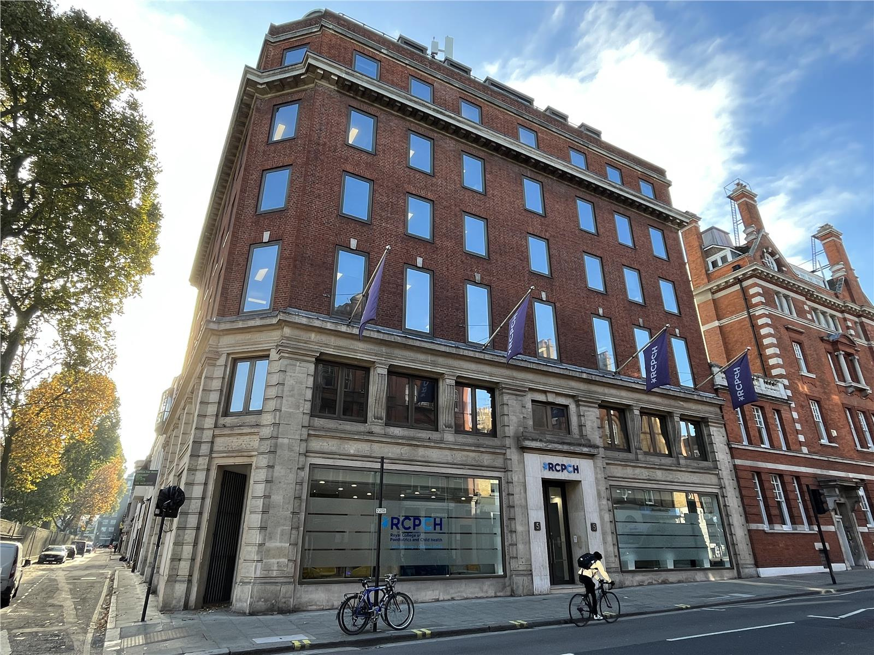

Who are RCPCH &Us?
We are the Royal College of Paediatrics and Child Health (RCPCH) the membership body for paediatricians in the UK and around the world.
We help train paediatricians, create guidelines and standards of care, support research and help write health policy across the UK.
RCPCH &Us is the RCPCH network for children, young people and families. 1000s every year get involved in helping to make health services the best they can be for under 25s. You can find out more about us at www.rcpch.us

Slide 3
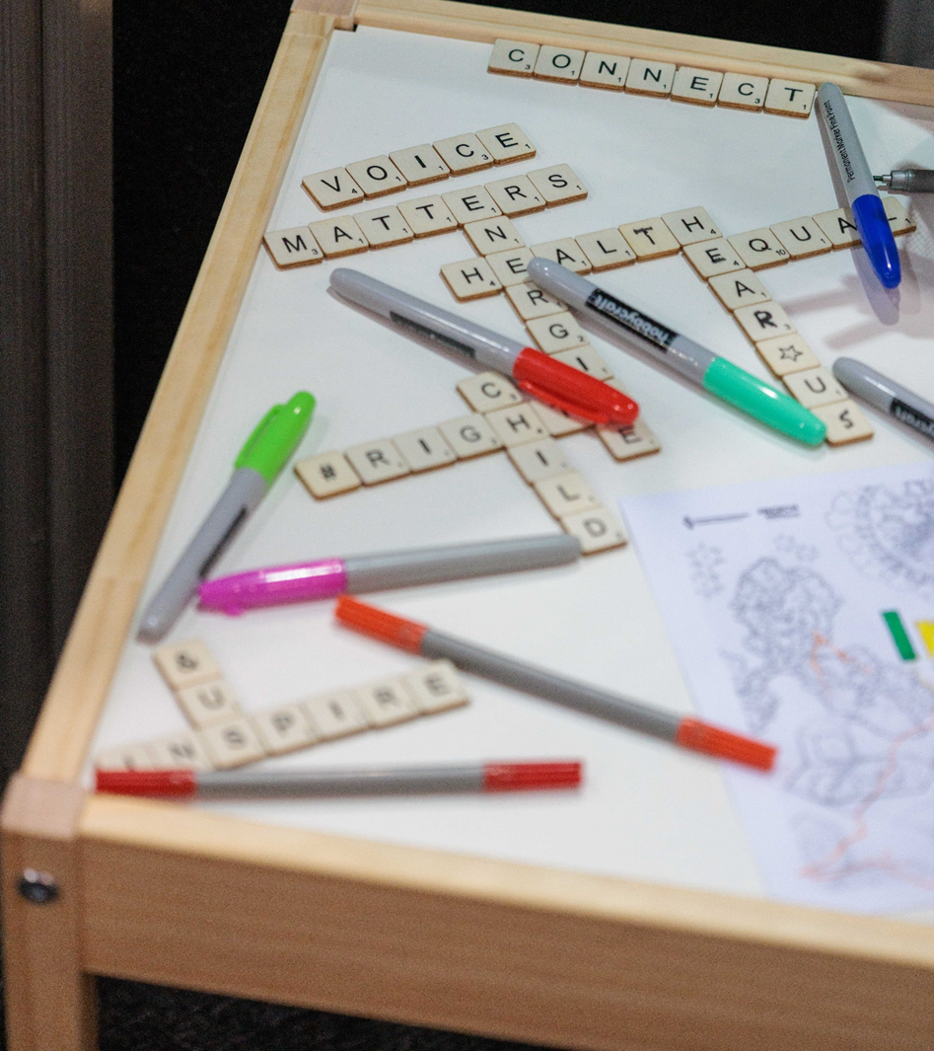
What is the State of Child Health 2026?
The State of Child Health is a report written by RCPCH and shared with governments in the 4 UK nations and decision makers. The report looks at the health and wellbeing of children and young people, using data across the UK. The report gives them evidence and recommendations to support changes to improve child health.
We want you to help RCPCH &Us to find out what matters to children and young people and to work out what topics the governments or decision makers should be working on.

Slide 4
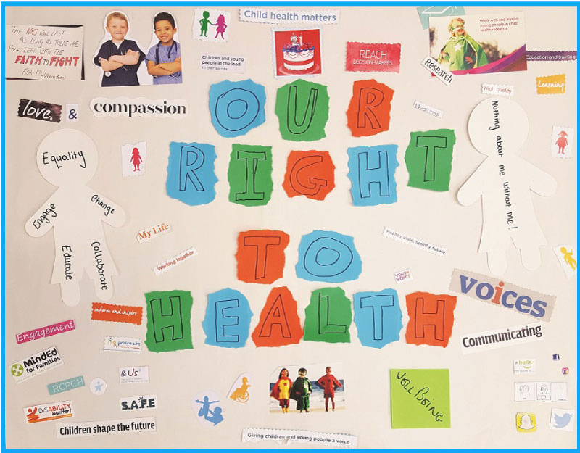
Why does it matter?
It’s your right as part of the United Nation Convention on the Rights of the Child to have your ideas and views influence decisions that affecting you (article 12). RCPCH wants to make sure that your right to have the best possible healthcare and health services is met (article 24).
We want you to vote on the topics that over 3000 children and young people told us mattered to them, so that we know which one is the most important one to start working on first. By having your say your voice can make real change.

Slide 5

Please vote for ONE topic that you think is the most important for the government to work on to improve the health of children and young people. This vote is open to children & young people up to the age of 25 in the UK.
Topics:
Support for your emotional health and wellbeing
Support for your physical health
Support to feel confident and ready to manage booking your appointments, get your prescriptions or visit health services on your own
Giving your ideas & getting invovled in shaping health services to meet your needs
Getting the right help, at the right time from the right health worker, wherever you are in the UK

Slide 6
Additional information for group leads

Slide 7
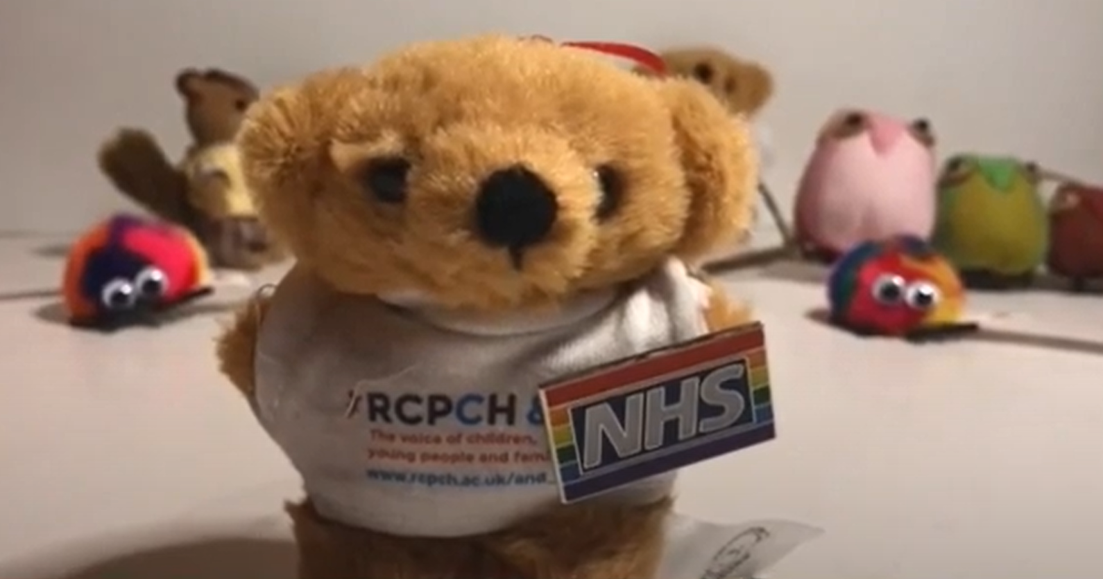
How can your children and young people get involved?
Vote in your groups by:
Doing a hands up vote & send us the results
Print the ballots, give one to each person, collate and send to RCPCH &Us
Show the ballot on screen, give out scrap paper so people can write their vote on it, collate and send us the results
Share the link to the MS Form so that people can vote individually
Remember you can only vote once and only for one topic.
If you have a bit more time, find out about voting, democracy & active citizenship. Talk about why voting matters & how to have your say.

Slide 8
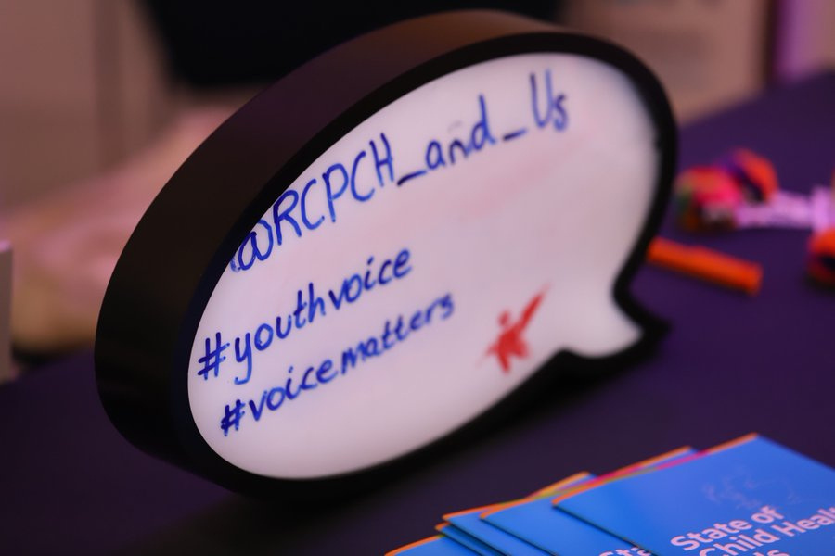
What happens next?
Submit your votes by 15 February 2026. We’ll count votes from across the UK in February 2026. The top issue will then be looked at by RCPCH &Us young people with staff and paediatricians from RCPCH and will be written up in the State of Child Health 2026. We’ll share results back with you in a youth-friendly report in summer 2026.
Send in your results:
If you have any questions or to send in results please email and_us@rcpch.ac.uk Don’t forget to tell us the ages of voters (under 25s only) & your location.

Slide 9
RCPCH &Us
Address
Email
Website
Podcasts
5-11 Theobald's Road, London WC1X 8SH
and_us@rcpch.ac.uk
www.rcpch.us
rcpchandus.libsyn.com/
#VOICEMATTERS | #CHILDHEALTHMATTERS
Royal College of Paediatrics and Child Health.
Incorporated by Royal Charter and registered as a Charity in England and Wales: 1057744 and in Scotland: SCO38299.
Registered Office 5-11 Theobalds Road, London WC1X 8SH.
Patron HRH The Princess Royal.

